Slide 1
Utilization Patterns of Perioperative Neuromuscular
Blockade Reversal in the United States
Tim Dubovoy, MD
Clinical Assistant Professor
Michigan Medicine

Slide 2
Introduction
Sugammadex – a novel NMB reversal agent
  FDA approval December 2015
  Capable of reversing deeper levels of NMB
  Costs more than neostigmine
Data on sugammadex use – largely based on international survey results
Outcome studies focused primarily on measures of efficiency
  Limited evidence for reducing postoperative complications
Adoption of a new drug may be hindered by cost concerns and arbitrary restrictions on the use of sugammadex
Notes:
Introduction of sugammadex to the US market in December of 2015 changed the landscape

Slide 3
Introduction
Study aimed to identify practice changes in the management of NMB reversal following FDA approval of sugammadex in the US
Our hypotheses:
  There would be wide variation in adoption of sugammadex across individual hospitals
  Sugammadex would be used in a minority of eligible patients
Notes:
Introduction of sugammadex to the US market in December of 2015 changed the landscape

Slide 4
Study Design
Retrospective observational study
  24 MPOG academic/private centers
  All had sugammadex on formulary at the time of the study
Inclusions
  Surgical procedures between Jan 2014 and August 2018
  All adults (>18 years) receiving NMB agents
Three distinct study periods:
  Before sugammadex was first used at each institution
  The transitional period – excluded from the primary analysis (0-6 months)
  After sugammadex – 6 months after first sugammadex use at each institution
Notes:
The presugammadex period
The transitional period = first 6 months after sugammadex was utilized at each institution
excluded from the primary analysis
The postsugammadex period = defined as 6 months after first sugammadex use at each institution

Slide 5
Study Design
Exclusions
  ASA ≥5; myasthenia gravis and/or pyridostigmine use
  CKD: preop GFR ≤ 30 mL/min or Elixhauser comorbidity
  Cardiac surgery, lung or liver transplantation
  Need for mechanical ventilation before or after surgery
  Median peep > 10 cm H₂O
  Cases receiving both neostigmine and sugammadex
  Administration of reversal to facilitate intraoperative neurologic monitoring

Slide 6
Variables of Interest
Primary outcome = administration of an NMB reversal agent
  Neostigmine, sugammadex, or spontaneous reversal
    Categorized by dose by dose ranges
Covariates
  Patient level: demographic/anthropometric, ASA status, Elixhauser comorbidities
  Case level: CPT case grouping by body region, emergent
  NMB and monitoring: total dose of NMB agents (ED95 equivalents), train-of-four counts (TOFc) before extubation
  Intraoperative timed events: time from last NMB to reversal, from reversal to extubation, time from last NMB to extubation
  Type of institution and provider type
Notes:
Covariates of interest included patient-level factors,
such as age, height, weight, sex, ASA physical status,
emergent status, World Health Organization (WHO)
body mass index (BMI) category, and Elixhauser
comorbidities.
Case-level covariates consisted of surgical procedures
defined by anesthesia Current Procedural
Terminology (CPT) codes grouped by body region,
admission type, number of documented train-of-four
counts (TOFc), last documented TOFc before extubation,
anesthesia type, primary in-room provider (faculty,
certified registered nurse anesthetist [CRNA], or
resident), and intraoperative timed events: time from
last NMB dose to first reversal, time from first reversal
to extubation, and time from last NMB to extubation.
Peripheral nerve stimulators were used to provide
qualitative measurement of NMB. Institution-specific
characteristics included university affiliation and
number of days since the first sugammadex case.
Additionally, participating institutions were asked
whether any institution-specific protocols or restrictions
regarding local use of sugammadex existed;
responses were recorded as a Boolean yes or no.

Slide 7
Statistical Analysis
Descriptive and trend – normalized for each hospital to the first documented sugammadex administration
  Categorical variables summarized with counts and frequencies
  Continuous variables summarized by medians and interquartile ranges
Multivariable mixed-effects logistic regression model controlling for institution to assess patient, procedure, and provider factors associated with sugammadex administration
Notes:
To evaluate how practice patterns change over time with the introduction of a new medication, the distribution of cases by reversal category was plotted per month since the FDA approval of sugammadex on December 15, 2015. Despite the single time point of sugammadex FDA approval, each hospital goes through its own process to add a medication to inpatient formulary and make it available for use. The date of first documented sugammadex administration at each institution was recorded.
Variation in NMB management before sugammadex availability and after 6 months of availability was compared using Pearson χ2 tests or
Mann–Whitney U tests, as appropriate

Slide 8
Patterns of Neuromuscular Blockade Reversal Across 24 Centers by Month

Slide 9
Patterns of Neuromuscular Blockade Reversal Across 24 Centers by Hospital
pattern = nonuniversity-affiliated institution
solid = university-affiliated institution

Slide 10
Total Cases
N=934,798
Before Sugammadex
N=421,754
Transitional
N=127,075
After Sugammadex
N=385,969
Neostigmine
N = 337,596
Neostigmine
N = 174,695
Sugammadex
N = 154,351
ED 95 of NMB per hour of case
No documented TOF
TOF 0-1 at reversal
TOF 3-4 at reversal
1.1 [0.8, 1.5]
28.9%
3.4%
60.4%
1.2 [0.8, 1.5]
24.2%
2.1%
66.2%
1.3 [0.9, 1.7]
21.1%
7.5%
49.5%

Slide 11
Total Cases
N=934,798
Before Sugammadex
N=421,754
Transitional
N=127,075
After Sugammadex
N=385,969
Neostigmine
N = 337,596
Neostigmine
N = 174,695
Sugammadex
N = 154,351
Median Neostigmine Dose (mcg/kg)
41.2 (31.9-50.4)
38.8 (29.9-48.3)
Sugammadex Dose* (mg/kg)
≤2 mg/kg | 34.8%
>2 to ≤4 | 52.6%
>4 to <12 | 6.1%
*36% of Sugammadex cases received a dose of exactly 200 mg

Slide 12
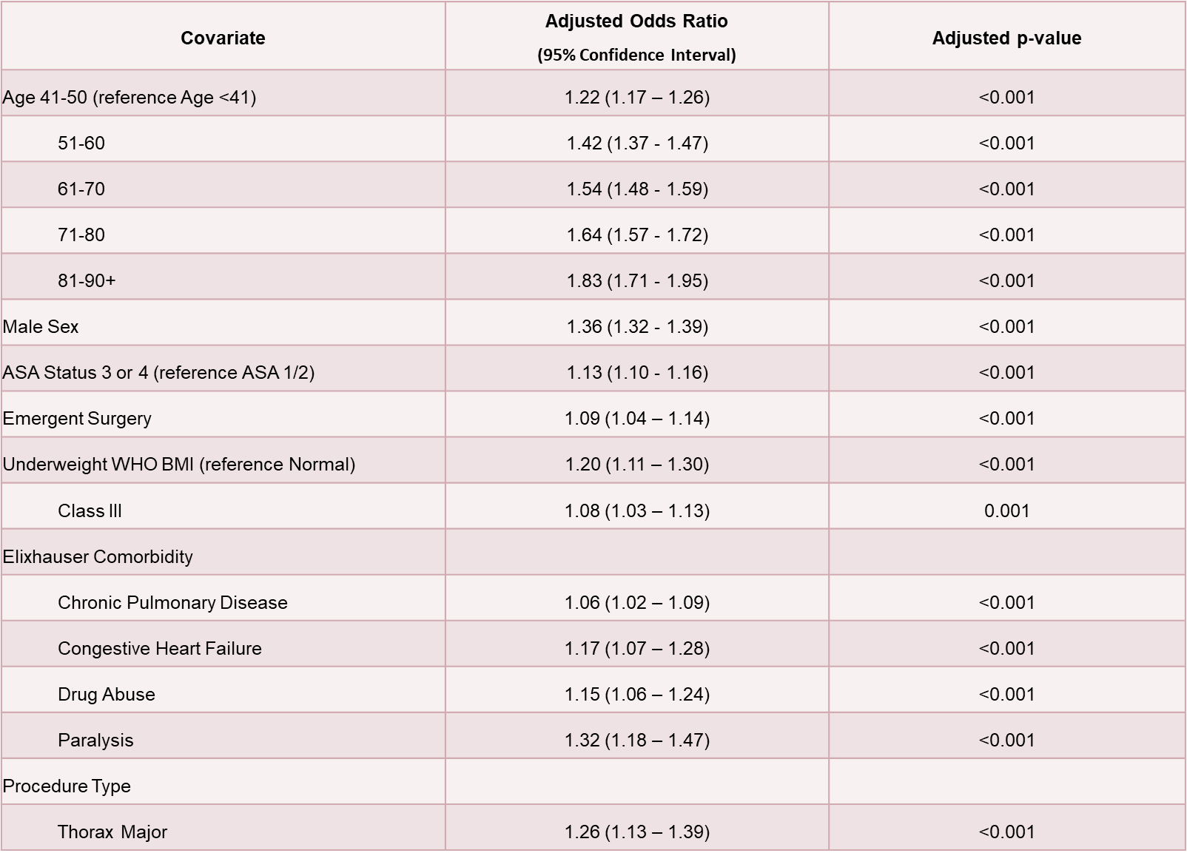

Slide 13
Covariate | Adjusted Odds Ratio (95% Confidence Interval) | Adjusted p-value
Last TOFc before extubation 0 or 1 twitches (ref 3/4) | 4.06 (3.83 – 4.31) | <0.001
Resident/Fellow In-Room Provider (reference Faculty Only) | 1.29 (1.23 – 1.35) | <0.001
CRNA | 0.79 (0.76 – 0.83) | <0.001
ED 95 of NMB per hour of case duration (ref Quartile 1)
Quartile 2 | 1.23 (1.18 – 1.28) | <0.001
Quartile 3 | 1.65 (1.58 – 1.72) | <0.001
Quartile 4 (high) | 3.01 (2.88 – 3.16) | <0.001
Non-university medical center | 0.06 (0.02 – 0.23) | <0.001

Slide 14
Lessons Learned
Our hypotheses:
  There would be wide variation in adoption of sugammadex across individual hospitals
  Sugammadex would be used in a minority of eligible patients
Overall, across all centers, sugammadex was used preferentially in patients with known risk factors for residual NMB or postoperative pulmonary complications
  Higher degree of NMB prior for reversal
  Limited physiologic reserves and medical comorbidities
  Surgical procedures that present high risk for postoperative respiratory complications
Notes:
Introduction of sugammadex to the US market in December of 2015 changed the landscape

Slide 15
Limitations
Scope was limited to FDA-approved indications and doses
  Did not examine uses outside of standard guidelines or special clinical scenarios
    Pediatric populations, CKD, “rescue”
We did no examine the effects of policy or practice restrictions that may have existed at the individual institutions
  Compliance with restrictions?
Notes:
Introduction of sugammadex to the US market in December of 2015 changed the landscape

Slide 16
Thank You

