Slide 1


Equity, Diversity and Inclusion & perioperative outcomes
MPOG Annual Retreat October 2, 2020
Nathalia Jimenez MD. MPH
Associate Professor & Vice Chair Equity Diversity and Inclusion,
Department of Anesthesiology and Pain Medicine ,
University of Washington, Seattle, WA

Slide 2


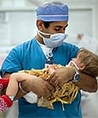

I have no conflicts of interest

Slide 3
Objectives
1. Describe key concepts of Equity, Diversity and Inclusion (EDI)
2. Explain what are Social Determinants of Health (SDOH) and its contribution to perioperative outcomes
3. Discuss strategies to incorporate EDI in perioperative outcomes research and QI

Slide 4

Outline
(1) Importance of equity, diversity and inclusion (perioperative care/outcomes)
- What are social determinants of health (SDOH)/ examples disparities in perioperative care
- demographic and socioeconomic factors in the US population
(2) One size does not fit all, how QI/QS efforts can increase disparities
(3) Promoting equitable outcomes
-The role of Quality improvement work & research
-Beyond adjusting, how to interpret disparities between population groups
-We found disparities, now what? moving from documenting to implementing solutions.

Slide 5

Should we care about diversity?

Slide 6
Paradigm
  All patients are equal
  I treat all my patients the same (equally) , I don't see race/ ethnicity/gender…
  Anesthesia is data driven-we use the same information for all patients (age, gender, weight, comorbidities, same fasting guidelines…)

Slide 7
anesthesiologists & Diversity (equity and Inclusion)
All patients are NOT the same
We treat patients differently
We strive for equitable care VS equal care
  Age → developmental range (physical, emotional & cognitive )
  gender → PONV, Sugamadex
  Race →
    differential prevalence-comorbid conditions
    population groups (i.e. sickle cell disease, cystic fibrosis)
    Genetic associations population groups-
    CYP2D6 and ultra-rapid codeine metabolizers
Anesthesia uses the same information for all patients→ BUT
We tailor care according to: age, gender, weight, comorbidities

Slide 8
Implicit Bias & medical care
Explicit (self-reported) beliefs known to the individual
Implicit (non-conscious) beliefs not readily apparent to the individual and can differ from a person’s explicit beliefs
implicit prejudice, discrimination, and bias can be observed in the absence of intention to discriminate. ( examples medical literature )
Implicit attitudes more frequent non-verbal behavior
Sabin et al. Physicians’ Implicit and Explicit Attitudes About Race by MD Race, Ethnicity, and Gender JHCPU. 2009; 20(3): 896–913
Sabin et al. The Influence of Implicit Bias on Treatment Recommendations for 4 Common Pediatric Conditions. American Journal of Public Health | 2012, Vol 102, No. 5

Slide 9
Anesthesia & implicit bias ?
Non verbal interaction with patients
Don’t have immediate feedback from patients (prophylactic tx PONV, Pain)
Quick decisions based limited number of variables

Slide 10
Disparities in Anesthesia care example 1.
Antiemetic Prophylaxis as a Marker of Healthcare Disparities in the National Anesthesia Clinical Outcomes Registry (Andreae et al)
Main finding: association between socioeconomic markers and anti-emetic prophylaxis (ondansetron and dexamethasone).
  Medicaid patients less likely to receive anti-emetic OR 0.85 [0.81, 0.89]
Methods:
  Use of large dataset (NACOR) 173,133 cases.
  Outcome anti-emetic prophylaxis → surrogate marker for anesthesia quality (availability, applicability, cost)
  Predictor socioeconomic indicators: Insurance and income (Beyond race)
Anesth Analg. 2018 February ; 126(2): 588–599.

Slide 11
What are Social determinants of health

Slide 12
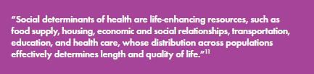
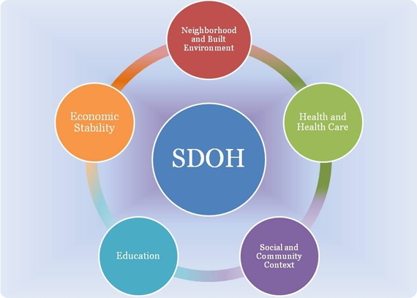
SDOH
Neighborhood and Built Environment
Access to Foods that Support Healthy Eating Patterns
Crime and Violence
Environmental Conditions
Quality of Housing √
Economic Stability
Employment
Food Insecurity √
Housing Instability √
Poverty √
Health and Health Care
Access to Health Care √
Access to Primary Care √
Health Literacy √
Education √
Early Childhood Education and Development
Enrollment in Higher Education
High School Graduation
Language and Literacy √
social and Community Context
Civic Participation
Discrimination
Incarceration
Social Cohesion – Family support √
Adapted from CDC model

Slide 13
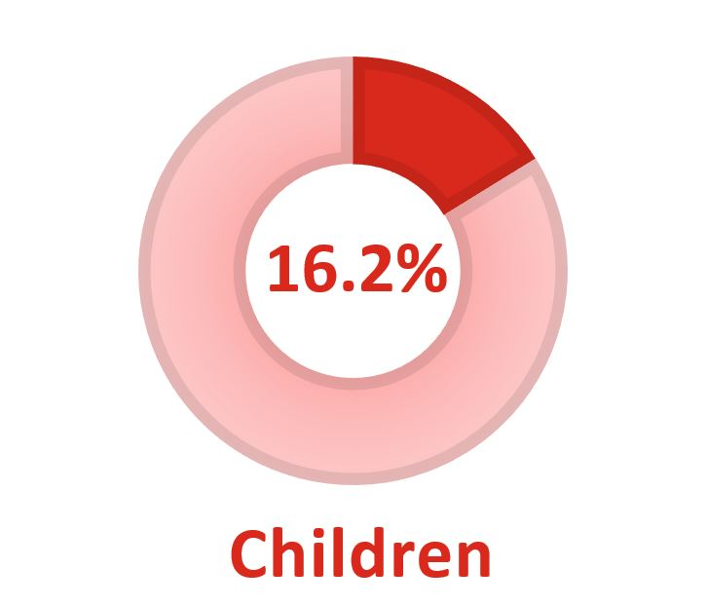
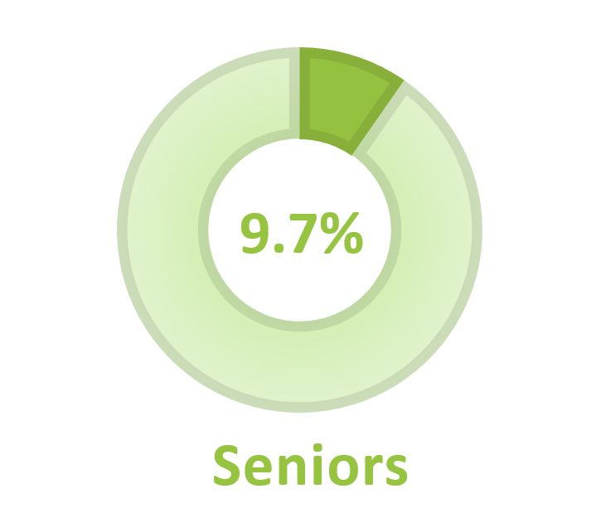
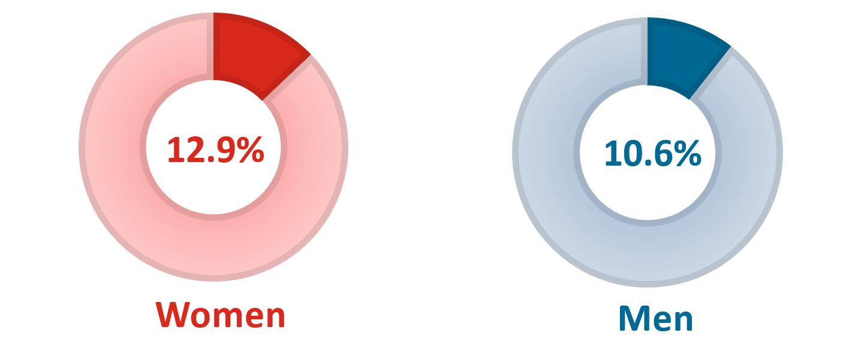
Poverty
38.1 million people lived in Poverty USA. poverty rate 11.8% (2018)
Distribution unequal
Higher among females
Higher among children

Slide 14
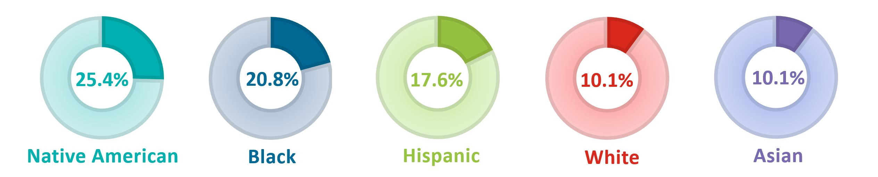
Poverty poverty line—for an individual was $12,784 yr
Higher among NA/AA/Hispanic

Slide 15
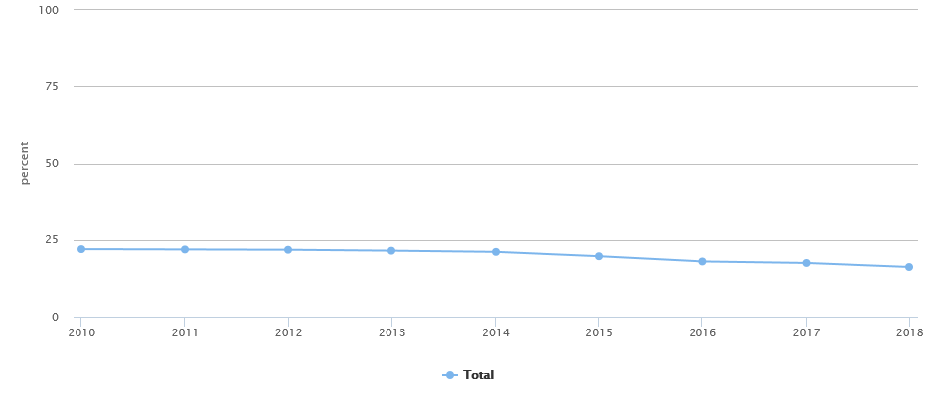
Poverty: Percent of US children <17 years living in poverty
Year 2019, a family of two adults and two children fell in the “poverty” category if their annual income fell below $25,926/yr.
Anesthesia
-Food insecurity
-Obesity/failure to thrive
-poor TX adherence
-Calls (phone minutes)
18% US
WA 10%
Office of Disease prevention and Health Promotion- Heathy People 2020

Slide 16
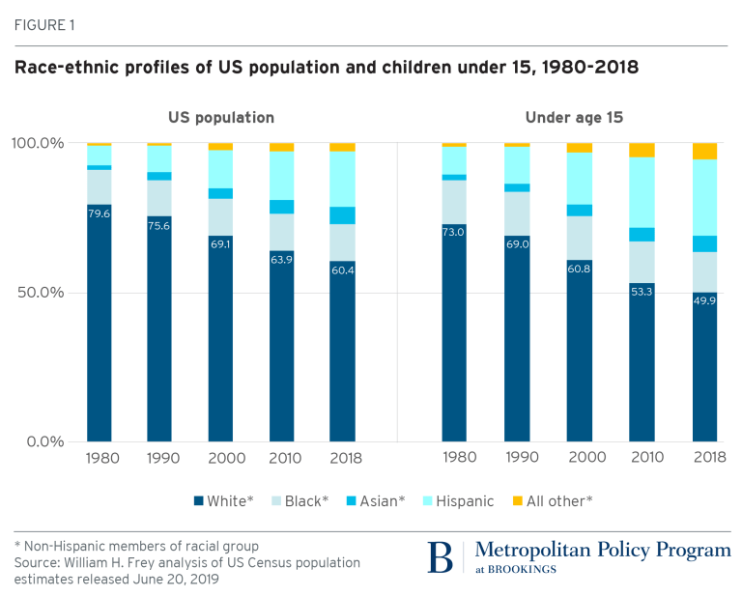
Demographic changes in the U.S
Race and ethnicity U.S population
is increasingly more diverse.
The biggest change is among Children

Slide 17
Disparities in anesthesia care example 2.
Race, Postoperative Complications, and Death in Apparently Healthy Children (Olubukola et al)
Main finding: AA children compared to White children had higher 30 DPOP mortality OR 3.43 (95% CI: 1.73–6.79), post-operative complications : 1.18 (95% CI: 1.13–1.23) and serious adverse events (OR 1.07; 95% CI: 1.01–1.14).
Methods:
  NSQIP-Pediatrics (2012–2017) 172,549 patients.
  Serious adverse events in healthy children (excluded ASA3+)
  Adjusting age, sex, age, RVU (complexity of procedure), year of procedure, case urgency and operating time.

Slide 18
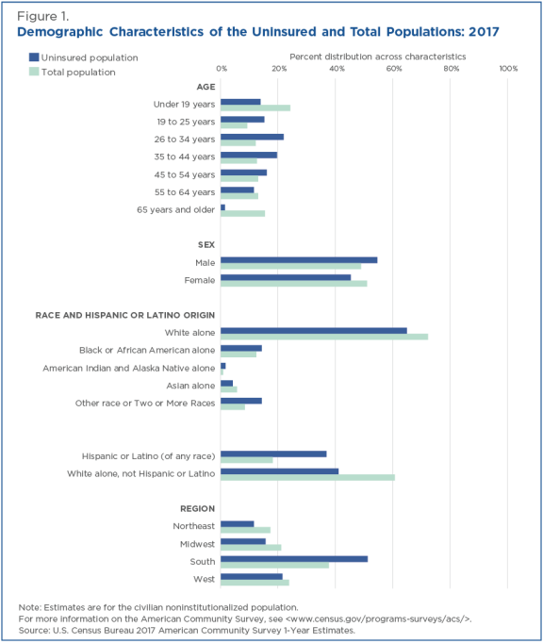
2017
Demographic characteristics of uninsured in the United States

Slide 19
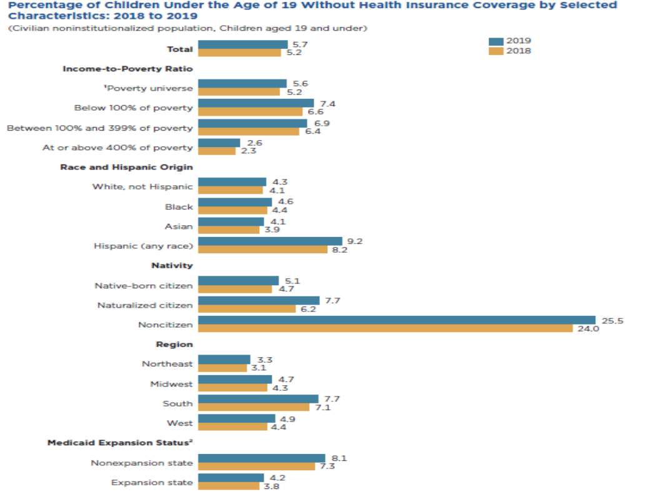
Insurance coverage by demographic characteristics
US census Data

Slide 20
Disparities in Anesthesia care example 3.
A Cross-Sectional Analysis of Community Water Fluoridation (CWF) and Prevalence of Pediatric Dental Surgery Among Medicaid Enrollees (Lee et al)
Main finding: Access to CWF is associated with lower caries-related visits and Dental surgery
Methods:
  Use of large dataset (Medicaid claims data) 436 counties within 5 states per year (872 county-year observations)
  Outcome Dental surgery under general anesthesia (Cost, resources , exposure GA pediatrics )
  Predictor public health intervention water fluoridation at the county level (regional variation)
JAMA Network Open. 2020;3(8):e205882..

Slide 21
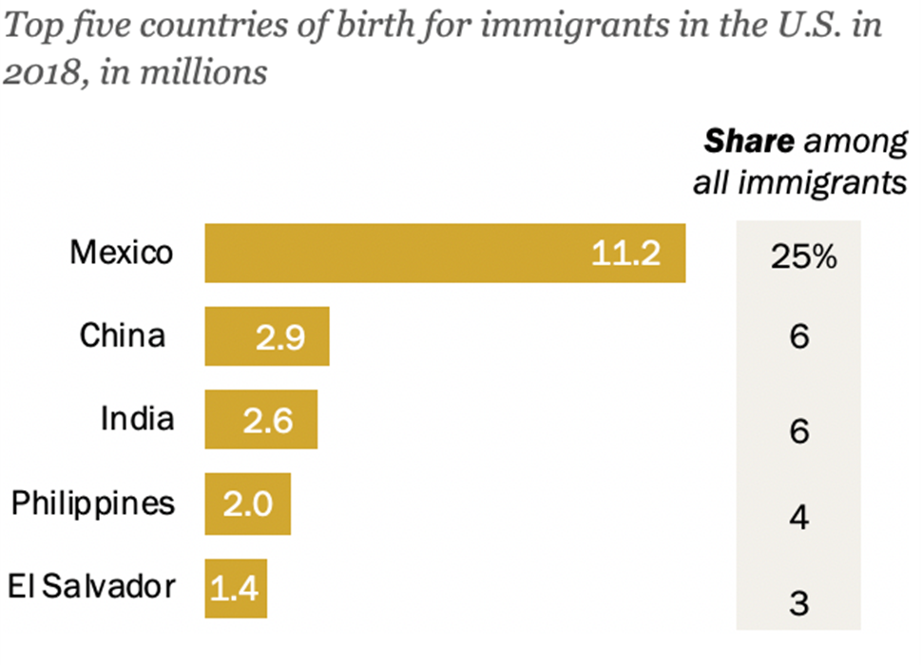
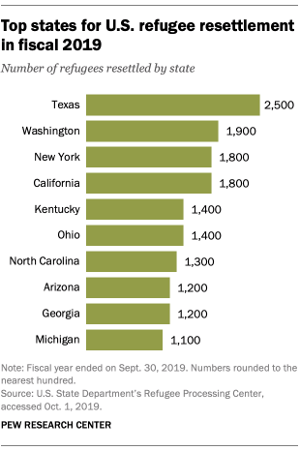
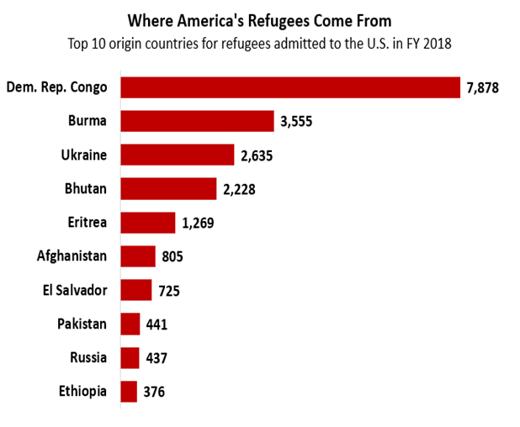
Refugees and immigrants:
SDOH
-LEP
-Health literacy
Anesthesia
-prior traumatic events
-coping
-anxiety
A refugee is someone who has been forced to flee his or her country because of persecution, war or violence.

Slide 22
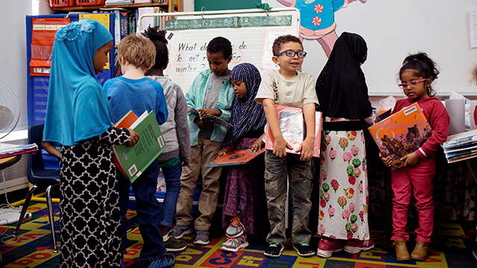
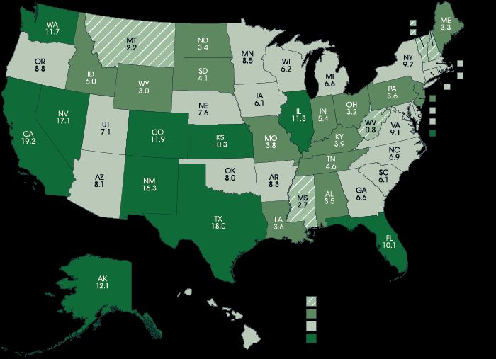
Immigrants and refugees
Limited English Proficiency (LEP)
Health literacy
<3%
3-<6 %
6-<10 %
>10%
nearly 5 million English language learners in U.S. public schools in fall 2015
represent 9.5% of U.S. public school enrollees, 8.1% in 2000.
~ 3/4 of students with LEP in U.S. public schools (77%) spoke Spanish as their primary language at home in 2015
PEW research center/ National Center for Education Statistics

Slide 23
Disparities in anesthesia care example 4.
Postoperative Pain Management in Children, Parental English Proficiency, and Access to Interpretation (Jimenez et al)
Main finding: Children of LEP parents had fewer pain assessments, were less likely to receive opioid analgesics compared with children of EP parents. More frequent use of professional interpreters mitigate differences.
Methods:
Small clinical dataset 474 patients ( 1 year data)
Matching by age group, surgical procedure, and admission date.
Assessment of intervention
Clinical and administrative dataset ( billing data interpreter services)
Hosp Pediatr. 2014 Jan; 4(1): 23–30.

Slide 24
EDI Research and Quality Improvement

Slide 25
Quality improvement (QI) approaches are appealing for addressing disparities
  QI strategies target modifiable aspects of care delivery
  Address multiple aspects of care in a systematic fashion
  Tailor care over time based on data monitoring.
  Policy supported IOM→ equity is a core domain of health care quality
  AHRQ formalized this link (quality equity) annual quality & disparity reports
  https://www.ahrq.gov/research/findings/nhqrdr/nhqdr18/index.html
  Supported by legislation: ACA requires collection of race/ethnicity data & reporting of quality performance measures stratified by race/ethnicity

Slide 26
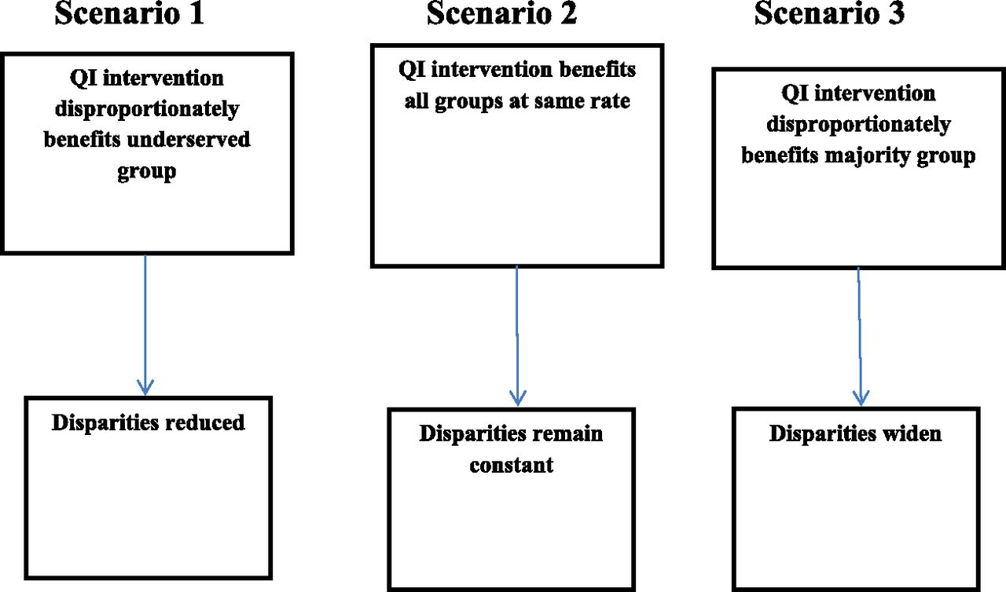

Potential effects of QI interventions on health disparities.
K. Casey Lion, and Jean L. Raphael Pediatrics 2015;135:354-361
©2015 by American Academy of Pediatrics
Notes:
Potential effects of QI interventions on health disparities. (Adapted from Weinick RM, Hasnain-Wynia R. Quality improvement efforts under health reform: how to ensure that they help reduce disparities—not increase them. Health Aff (Millwood). 2011;30[10]:1838–1839.)‏

Slide 27
QI interventions may not improve disparities
In some cases, disparities may worsen
greater uptake or effectiveness of the intervention in the population with better outcomes at baseline.
Standardized clinical pathways (do not account for differences in populations)
benchmarking (avoidance of higher risk patients)
performance incentives (avoidance of patients barriers for adherence treatment)
public reporting
provider reminder systems, and decision aids. (difficult heterogeneity)

Slide 28

Addressing Disparities example 5.
Reduction of Peripartum Racial and Ethnic Disparities-A Conceptual Framework and Maternal Safety Consensus Bundle. (Council on Patient Safety in Women’s Health Care-Toledo P)
https://safehealthcareforeverywoman.org/patient-safety-bundles/reduction-of-peripartum-racialethnic-disparities/
Multidisciplinary group
Commitment to address racial & ethnic disparities
Bundle created within framework of SDOH
  Systematic approach support systems in addressing disparities
    Readiness
    Recognition
    response
    Reporting –systems learning
Obstetrics & Gynecology 2018 – V 131 - 5 - p 770-782

Slide 29
Disparities Research especial consideration
Research methods should adapt to population characteristics and sociocultural environments i.e. IRB (confidentiality, data management)
Cultural/linguistic considerations challenge the use of mainstream interpretations of standard evaluation techniques. (i.e. Scales)
do no harm to the populations involved. i.e. Research subject protection issues and poss. of biases can lead to misinterpretation of results

Slide 30
Disparities Research difficulties
Clinical trials, longitudinal cohort studies →
  Recruitment (lack of trust in the system)
  Cost (i.e. Interpretation and translation of materials)
  Adherence (follow up- migrant workers, high mobility populations)
Existing data →
  No data (before ACA, no data on race/ethnicity except for Medicaid/Medicare)
  Inadequate data race/ethnicity (assigned vs self- reported);
  Data based in obsolete constructs gender (binary)

Slide 31
Recommendations from the National Institute on Minority Health and Health Disparities (NIMHD)
formative
  needs assessments (informed by key stakeholders)→
    research relevant to the community and context
    draw upon the assets of the population
  Process: instruments, policies, timing, training, data collection, reliability of the practices, and adherence to the design
design and methodology
  Etiologic research should assess exposures and outcomes at multiple levels
  Interventional: multilevel interventions
summative (outcomes, impacts, and cost)
Am J Public Health 2019 ;109(S1):S34-S40.

Slide 32
Summary
1.Social Determinants of Health (SDOH) contribute to perioperative outcomes
2. equity is a core domain of health care quality
3. Data, Data → to address disparities we need to measure & monitor them
4. QI interventions may reduce disparities if appropriately implemented
5. Disparities research is needed and can be done if it is rooted in the needs and strengths of vulnerable populations

Slide 33
Questions?
Nathalia Jimenez
njimen@uw.edu

