Slide 1
MPOG 2020 Virtual Annual Retreat Sachin Kheterpal October 2, 2020

Slide 2
Disclosures
I have no personal financial, consulting, contractual relationships with any vendor
I am PI or co-PI on funded projects
NIH re: T32 training program
BCBSM re: anesthesiology QI
Merck re: Neuromuscular Blockade Monitoring and Reversal
Becton Dickinson re: Medication Error Epidemiology and costs
Apple re: trajectories of health detected by digital phenotyping

Slide 3
Thanks
Kevin Tremper Nirav Shah Katie Buehler
Mark Dehring Tory Lacca John Vandervest
Genevieve Bell Chris Heiden Michelle Romanowski
Shelley Vaughn Anik Sinha Brooke Szymanski
Jay Jeong Robert Coleman Jenny Mace
Jeremy Jared Mike Burns Nick Douville
Tomas Medina Allison Janda Meridith Bailey
Mike Mathis Douglas Colquhoun David Clark
Nicole Pescatore Ben Cloyd Chelsea McKinney
George Mashour
MPOG chairs, PIs , ACQRs, quality champions, and software developers
All the clinicians, IT staff, and administrators out there

Slide 4
Anesthesiologists making us proud
Lee Fleisher CMO, CMS James Grant, CMO, BCBSM

Slide 5
Thank you to everyone
COVID sucks
Faculty and staff redeployed during COVID surges across country
Anesthesiology, nursing, IT, and administrative pride
Praying to not need your service again

Slide 6
MPOG and COVID
Remote work and collaboration using Webex / Zoom is our default way
Many of our staff have flex hours, work from home schedules
Building relationships and trust through shared mission, not shared location is our culture
Wish we could laugh and cry together

Slide 7
What have we done, and where are we headed?

Slide 8
An uncertain but productive year at MPOG coordinating center & sites
2 weddings, 1 engagement, 4 babies
Stable and maturing staff and faculty group
Welcome new contributing sites
Dartmouth-Hitchcock University of Chicago
UC, San Francisco MD Anderson Cancer Center
Henry Ford Allegiance, Macomb, Wyandotte
> 20 states, more than 50 hospitals/health systems, 14.5M anesthetic records
More than 30 sites converted to latest MPOG integration software (“Import Manager”)
MPOG was made for this…

Slide 9
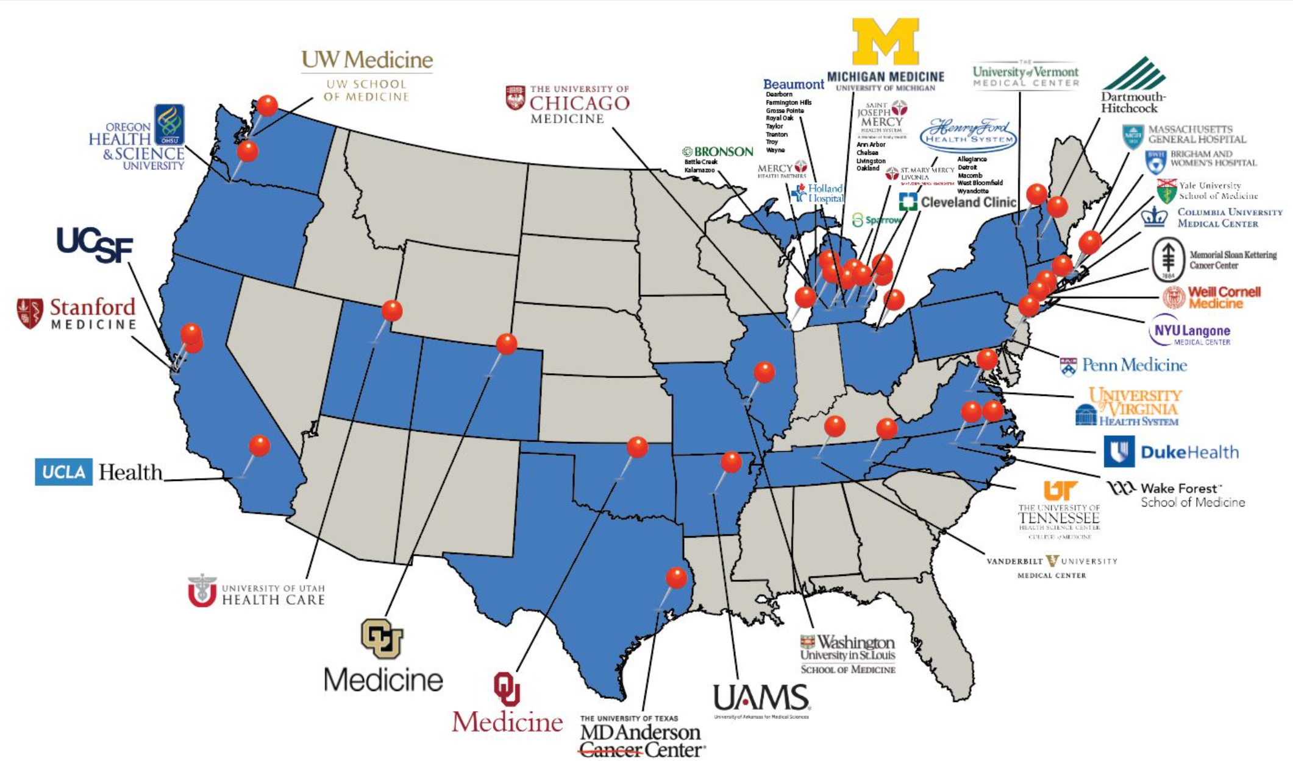

Slide 10
Progress
Financial and governance stability
Sustained support from BCBSM, research funders, MPOG sites
Diverse forms of value to our members (QI, research, MOCA, hospital leadership)
MPOG executive board with turnover, fresh perspectives, and support
Research operations and redundancy
Publications committee moderators
Data extract analysts
Team effort to structure proposal development, review, data extract, and analysis
Reliable NIH (R, K) and Foundation funding for MPOG sites using MPOG data
Strong, diverse research proposals from many different sites

Slide 11
Progress
Quality improvement
Vibrant specialty subcommittees Revised dashboard
Measure review Focusing on the right measures
Advancing the culture of ASPIRE
IT and Administrative
Sophistication of tools
Robust product planning process
Predictable upgrade and product release schedule
More consistent and independent onboarding process
Staff depth and specialization
Tools that help research and QI (Blinded record index, data direct)

Slide 12
Data integrations to enable QI and research
Surgical registry
More by Dr. Michael Mathis
National (local linking at each site): STS-Thoracic, STS-Cardiac, ACS-NSQIP
State: MSQC (a version of NSQIP), MTQIP (trauma) in progress
Payor
National: CMS (thank you Yale and Dr. Schonberger)
State: MVC (thank you BCBSM)
Blinded record index
In production across all of MPOG
Enables centralized linking to any dataset without sharing identifiers
Mortality, patient flow between hospitals

Slide 13
Where do we need to go?
Do more with the data we have
It’s a QI and academic “goldmine”
Enhance the research and QI integration
The “learning health system”

Slide 14
Do more with the data we have
Cleaning up our “phenotypes” and “collations”
Hiding ones that aren’t ready for broad consumption - Emphasizing ones that are ready
Use quality metrics as exposures and outcomes
EXTREMELY well curated data (by 4,500 people every month)
Use DataDirect to define 90% of inclusion/exclusion criteria
Focus on research and QI topics leveraging recent, high quality data
Intraop record PACU Discharge ICD10 Lab values
Reliable intraop observations

Slide 15
Do more with the data we have
Use MPOG data as a foundation for prospective, funded work
Pragmatic clinical trials
Prospective observational cohort studies
Take advantage of merged dataset that extend beyond EHR
Create research and QI “themes” across centers that build upon one another

Slide 16
Enhance QI and research integration
Publish
All of our work is clinically ground
However, do the missions “feed” each other enough?
Research benefits from QI data quality obsession
QI benefits from clinically meaningful research
How often and with what mechanism do we share needs across QI and Research committees?
“Learning Health Systems”
Interpret
Results
Analyze
Data
Develop & Pilot Toolkit
Data to Knowledge
Knowledge to Practice
Quantitative Analysis
Qualitative Analysis
Assemble
Real-World Data
Iterate, Disseminate
Hypothesis

Slide 17
Summary
It’s been a strange, productive, sad, and inspiring year
Amazing how much progress MPOG sites and Coordinating Center have made
MPOG is the foundation for pragmatic anesthesiology research and QI
We need to leverage the last decade of data and collaboration investment

Slide 18
Thank you

