Slide 1
Integrating your MPOG Data with Surgical Registry & Payor Data
Michael Mathis, MD
Assistant Professor of Anesthesiology
Associate Research Director, MPOG
Notes:
Strength in collaboration – not only by collaborating across centers → MPOG
But also by collaborating across database registries
- STS, NSQIP, and Payor data via CMS / BCBS
Touch upon some opportunities

Slide 2
Intra-op
Physiologic / Vent
Times/Providers
Meds/Fluids
Interventions
Administrative
ICD-9/10
Pre/Post-op
Structured H&P
Surgical Procedure Details
Outcomes
Laboratory / Testing
Demographics
Notes:
Start with discussion of surgical registries
Credit to cardiac anesthesiologist at Michigan Medicine, Allison Janda for many of these slides together – may recognize it from breakout session
Strengths/unique features of MPOG data
Intraop
Granularity
Minute-to-minute physiologic, ventilator, medication/fluid; timestamps, providers, and interventions
Also access to administrative data → pro fee diagnosis codes, administrative discharge ICD-9/10 codes
Strength/unique feature STS
Preop and Postop
Quality from painstaking manual review/patient follow-up
Detailed structured history/physical, surgical procedure details
Very importantly, outcomes data → mortality, hospital LOS, organ system complications

Slide 3
Opportunities via database integration:
Intraop Practice Patterns & Postop Outcomes
MPOG
Physiologic Inputs/Outputs
Medications Intraop Events
Central Repository
Surgical Registry
H&P / Outcomes
Notes:
If successfully integrating this data, can achieve opportunities for research/QI unable to be achieved by either database alone
Can work to integrate surgical registry & MPOG data into one location
Accessible to both groups with appropriate monitoring of data access & peer review
Through combining high-quality processes of care data through MPOG, and high-quality outcomes data through surgical registries
Can generate innovative studies like this one lead by Thoracic Anesthesiologist Randy Blank, Thoracic Surgeon Benj Kozower and the UVA team
Positive externalities – engages surgeons, reinforces relationships that start in the OR, takes them into realms of collaborative research & QI

Slide 4
Current Status of NSQIP and STS Integrations
NSQIP
12 sites completed
STS-Adult Cardiac Surgical Database (STS-ACSD, aka “STS Cardiac”)
3 sites completed, 5 in process
STS-General Thoracic Surgical Database (STS-GTSD, “STS Thoracic”)
8 sites completed
STS-INTERMACS (LVAD database)
Tentative, in process @ coordinating center
Notes:
STS-ACSD → Umich, OHSU, Colorado…. MGH, BWH, WUSTL, HFH, Hopkins in pipeline
STS-GTSD → Umich, OHSU, Colorado, Vermont, UVA, WUSTL, Yale, MSKCC

Slide 5
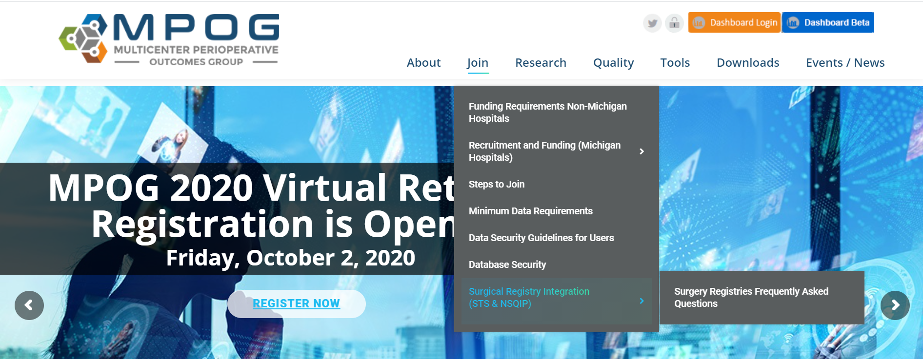
Where to start
Integration “Playbook”: MPOG → Join → Surgical Registry Integration
Surgeon Champions
IRB leads
IT leads
Notes:
Where to start?
Spell this out in great detail, via step-by-step integration on MPOG website
Conversations to have:
Clinical Champions → Surgeon heads of practice for registry they represent
IRB personnel
IT → MPOG has IT, so does NSQIP/STS
Be prepared for questions
- FAQ document, which reviews the goals of the integration, the secure transfer of data, the means for involving surgeon colleagues in the reviewing/approving of collaborative research

Slide 6
Can MPOG-ASPIRE Participation Lead to Reduced Healthcare Costs?
Payment Type | Difference-in-differences estimate ($) | p-value
Index Episode | -346.05 | 0.110
Post Discharge | -354.30 | 0.002
Readmission | 45.57 | 0.580
Professional Fee | -54.22 | 0.192
Total Episode | -718.62 | 0.023
Notes:
Briefly switch gears, and discuss opportunities not just with surgical registries, but payor data
New initiative within MPOG is to also seek de-identified claims data from the Centers for Medicare and Medicaid Services (CMS), Blue Cross Blue Shield of Michigan (BCBSM), Blue Care Network (BCN)
We’ve been fortunate to gain access to CMS data as supported by an NIH grant led by Dr. Schonberger at Yale, and
We’ve also started at Michigan, through access to data within a quality collaborative – the Michigan Value Collaborative – amalgamates these claims data from CMS and the Blues, with
- aim to improve the health of Michigan through sustainable, high-value healthcare
- Episode payments are risk adjusted, by age, gender, comorbidities, high spending for the prior six months and payer
Cost avoidance related to surgical collaboratives has been assessed, but anesthesiology CQI data is limited^{2-4,6,8,9}
Presents unique opportunity for MPOG/ASPIRE, to demonstrate a return on investment to BCBS as we improve care/reduce costs
We have very promising preliminary results in a study lead by Dr. Allison Janda
For all payers across all procedure types (major abdominal, and orthopedic), we found significantly greater reduction in post-discharge and total episode payments for procedures performed in ASPIRE hospitals compared to non-ASPIRE control hospitals
********************
Procedure types included: colectomy, colorectal cancer resection, gastrectomy, esophagectomy, pancreatectomy, hysterectomy, joint replacement (knee and hip), and hip fracture repair
Baseline period: 2014
Experimental period: June 2016 to July 2017 (BCBSM data) or June 2016 to July 2017 (Medicare data)
Not included: January 2015 to May 2016 (initial 18-month implementation period for ASPIRE)
Case-Mix Index Ratio
Above vs. below 1.67
Teaching Status
Teaching vs. Non-teaching
Bed size
25-49 vs. 100-199 vs. 400-499 vs. 500 or more
MVC Cohort Grouping
Cohort 1 vs. 2 vs. 3
Surgical CQI Participation
MSQC Participation as of 2014
MARCQI Participation as of 2014
Attempting to add Leapfrog Hospital Rating
Difference-in-differences analysis to evaluate whether ASPIRE implementation was associated with decreased payments compared to payments at non-ASPIRE sites

Slide 7
Questions / Discussion (Additional Slides on BRI)
Notes:
Pause here
If Sachin is available, can discuss our means for matching but still de-identifying MPOG + Registry data

Slide 8
Database Integration Privacy & Security
The need: link data sources but remove identifiers
IRB requirements
Ethical – if you don’t need the identifiers, you shouldn’t use them
The solution: Blinded record linking
For merging datasets across sites without PHI
Using NIST Secure Hashing Algorithm
Incorporate RSA secure key
Keep the hashed codes centrally, no source identifiers
Hashed codes are one-way (cannot be “undone”) but can be linked across data sources
Established
Public domain hashing algorithm
“blessed” by AHRQ in registries manual as non-PHI
Approved by IRBs, DUA at all MPOG institutions
Notes:
Privacy/Secrurity – brought up these issues during research and QI meetings, but bears repeating because so important to the integrity of the MPOG database
NIST = national institute of standards and tech

Slide 9
Data Source 1
Blinded Record Index (BRI)
At University of Michigan
MPOG
Database
(Identifiers)
Secure Key
Source1 Code1
No PHI
Fire Wall
Fire Wall
BRI Software
Multiple Hash
Fire Wall
Hash | Code 1
Hash | Code 2
Hash | Code X
https
BRI
Multiple
Hash

Slide 10
Data Source 1
Data Source 2
Blinded Record Index (BRI)
At University of Michigan
MPOG
Database
(Identifiers)
Death Master File
(Identifiers)
Secure Key
Source1 Code1
Source2 Code2
Source2 Code3
No PHI
Secure Key
Fire Wall
Fire Wall
BRI Software
BRI Software
Multiple Hash
Fire Wall
Fire Wall
Multiple Hash
Hash | Code 1
Hash | Code 2
Hash | Code X
Hash | Code 1
Hash | Code 2
Hash | Code X
https
BRI
Secure Key
BRI
https
Multiple
Hash
Multiple
Hash

