Slide 1
The impact of the COVID-19 pandemic on surgical case volumes at MPOG hospitals
Orestes Mavrothalassitis, MD
Resident Physician, Department of Anesthesia and Perioperative Care
University of California San Francisco

Slide 2
Introduction
Significant national COVID-19 morbidity and mortality
7M confirmed cases in the US so far
Over 200,000 deaths in the US so far
Routine hospital operations have been disrupted
Elective surgeries cancelled/postponed
PACUs and operating rooms converted to ICUs
Medical and non-medical staff reassigned to new roles
Unclear timing, scope, variance, and consequences of changes to perioperative patient care across the country

Slide 3
Study Design
Observational study – 33 MPOG academic/private centers
Inclusions
Surgical procedures 01/2019 to 05/31/2020 (most recently available data)
Adults (>=18yo)
Patients from sites continuously submitting data through the study period
Exclusions
Patients without outcome status available (mortality)

Slide 4
Outcomes and Variables
Primary outcome
Weekly surgical volume (total and by center)
Secondary outcome
Case mix (proportion of each procedure and absolute numbers)
Exposure
Date of surgery
National COVID data
Pandemic period (pre-, intra-, and ultimately post-pandemic)
Covariates
Demographic data
ASA status, comorbidities, preop lab and vitals data

Slide 5
Statistical Analysis
Join point regression to identify significant time points
Causal analysis with target maximum likelihood estimate (TMLE)
Bias: unmeasured confounders
Missing data: MICE and missingness indicators

Slide 6
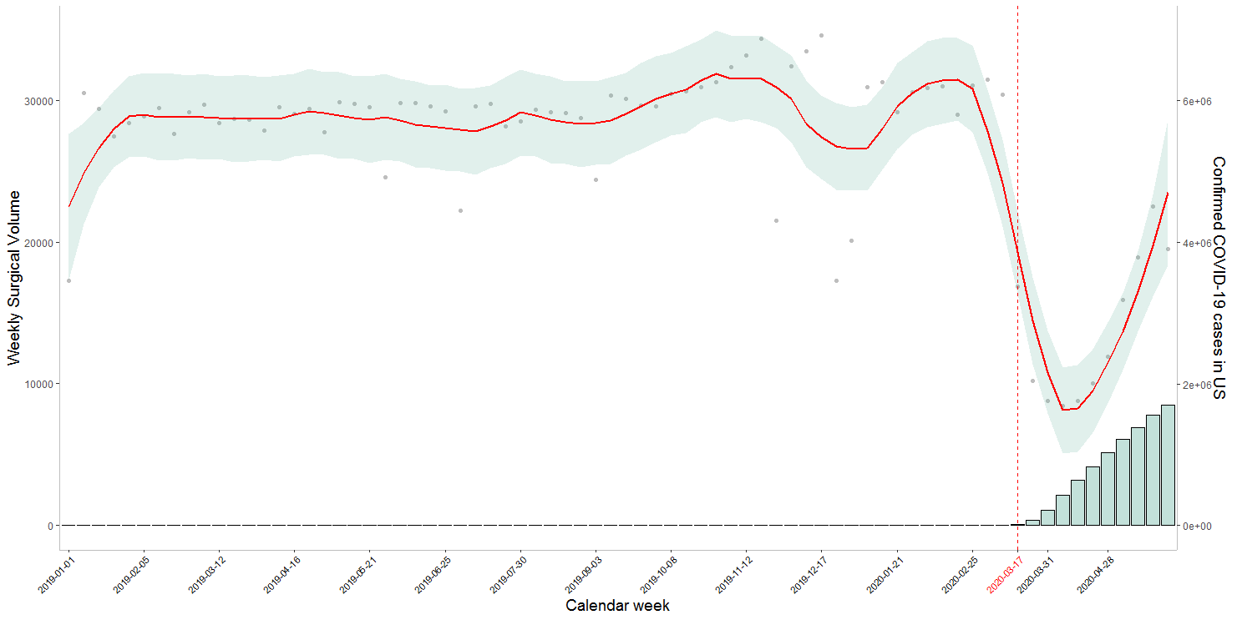
Preliminary Results: Timeline of surgical volume reduction

Slide 7
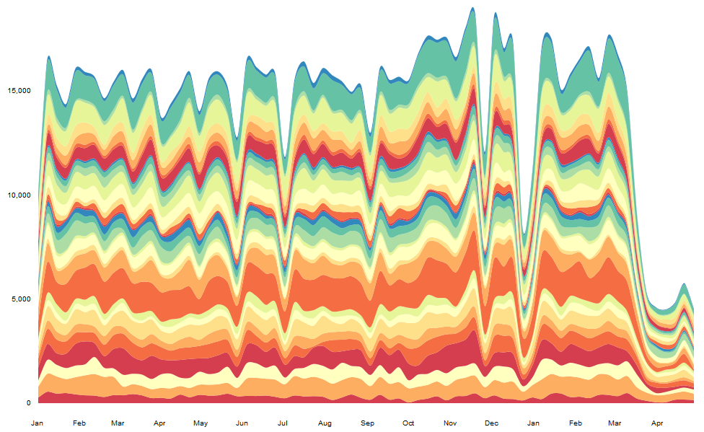
Preliminary Results: Weekly surgical volume by center

Slide 8
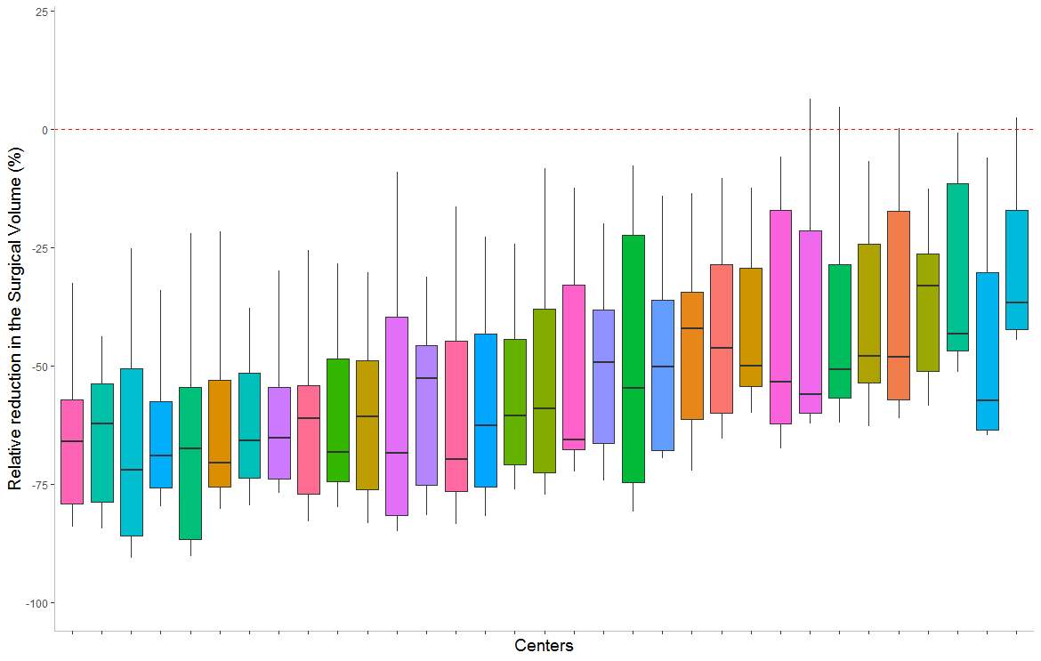
Preliminary Results: Heterogeneity in volume reduction

Slide 9
Summary of Preliminary Results
Dramatic decline in national surgical case volume during the week of March 16th, 2020
Nadir of national case volumes the week of April 6th, 2020 (71% reduction compared to same week in 2019)
Heterogeneity of volume reduction, with per-institution reductions ranging from 33% to 72%
Surprisingly, dramatic rebound in national surgical case volume to near baseline by 05/31/2020 (despite surging COVID cases)

Slide 10
Next Steps
Complete case mix analysis
Questionnaire for each center to understand site-specific factors influencing changes in case volume and case mix
Evaluate impact of major public health events/recommendations/mandates on observed national perioperative trends
Possible addition of patient-level COVID19 status MPOG data
Follow-up outcomes study

Slide 11
Lessons Learned
Wrestling with DataDirect
Tool continues to evolve – MPOG central receptive to feedback on bugs or enhancements; communicate early and often
Not all variables are created equal
Some variables exist in principle, but…
Must keep in mind that the quality of real-world EHR data reflects the intended primary use (e.g. clinical care / billing, rather than controlled experiment)
Feedback from experienced MPOG collaborators is crucial! Don’t re-invent the wheel
Recent rapid expansion of MPOG member hospitals
Currently 51 and counting, great for the present and future of MPOG!
Keep in mind there may be far fewer sites available for inclusion in your study if you are looking back prior to 2019

Slide 12
Acknowledgements
UCSF
Matthieu Legrand, MD, PhD (study PI)
Romain Pirracchio, MD, PhD (lead statistician)
Daniel Lazzareschi, MD
University of Michigan/MPOG support
Michael Mathis, MD
Sachin Kheterpal, MD, MBA
Shelley Vaughn
Mark Dehring
Washington University St. Louis
Anshuman Sharma, MD, MBA

Slide 13
References
COVIDSurg Collaborative. Global guidance for surgical care during the COVID-19 pandemic. Br J Surg 2020;
CMS Releases Recommendations on Adult Elective Surgeries, Non-Essential Medical, Surgical, and Dental Procedures During COVID-19 Response | CMS [Internet]. [cited 2020 Aug 7];Available from: https://www.cms.gov/newsroom/press-releases/cms-releases-recommendations-adult-elective-surgeries-non-essential-medical-surgical-and-dental
Sun E, Mello MM, Rishel CA, et al. Association of Overlapping Surgery With Perioperative Outcomes. JAMA 2019;321(8):762–72.
Dong E, Du H, Gardner L. An interactive web-based dashboard to track COVID-19 in real time. Lancet Infect Dis 2020;20(5):533–4.
De Filippo O, D’Ascenzo F, Angelini F, et al. Reduced Rate of Hospital Admissions for ACS during Covid-19 Outbreak in Northern Italy. N Engl J Med 2020;383(1):88–9.

