Slide 1
QI Update Product Planning Update
MPOG Annual Retreat
October 2, 2020

Slide 2
Disclosures
No personal consulting, financial, or board membership with any company
I am a PI/Co-I on projects that receive grant funding from
Blue Cross Blue Shield of Michigan
Apple, Inc
NIH
Edwards Lifesciences

Slide 3
Objectives
2019 QI Plan Reflection
Describe MPOG Product Planning Process
Application Development 2020
Plans for 2021 and beyond
Out by 2:30 ET

Slide 4
Please feel free to ask questions or provide feedback at any point by unmuting yourself or via Zoom chat

Slide 5
MPOG
Research
Quality Improvement
(ASPIRE)

Slide 6
Reflection
What We Said in 2019 | What We Did in 2020
Focus on measures that need to be addressed on a systems level | Mort 01 – 30 day in hospital mortality
Evolve our attribution philosophy from “failed” case to “flagged” case | Changed verbiage on QI reporting tools to “passed” and “flagged”
Allow modification of MIPS/ former QCDR measures | Modified these measures based on Quality Committee feedback
Create a formal measure review process | Created ASPIRE Measure Review Schedule and assigned measures to Quality Champions

Slide 7
Reflection
Measures/Data that we said we would build in 2019 | What did we do in 2020?
Glycemic management | GLU 03, O4 (glycemic management measures including PACU data)
Include transfusion management data from PACU | Pending
Hypotension risk adjustment | Pending
SUS 02 (Sustainability) | Pending
Understand AKI better | Developed AKI Toolkit
Pediatric/ OB Anesthesia Measures | Temp 04-Peds, OME (T&A), ABX-01-OB
Sugammadex Data | Sugammadex data presented at July ASPIRE meeting

Slide 8
Sugammadex or Neostigmine across MPOG?

Slide 9
Our QI Plan for 2021

Slide 10
GLU 05, 06
Hyperglycemia treatment and appropriate Preop glucose check
SUS 02
GWF inhalational agents
PUL 04
Respiratory bundle
Peds + OB + Cardiac subcommittee recommended measures
Registry Outcomes on QI Reporting (MSQC, NSQIP, STS, etc)
More informational/best practice measures (ASPIRE 2.0)
MPOG QI Stories at Quality Committee Meetings
Notes:
Reducing response times from 90 to 45 mins, reducing gas flows even further, data on TIVA rates, use of IV Tylenol, etc

Slide 11
MPOG Product Planning Update

Slide 12
Product Planning Themes
Ability to easily access data that you submit
Turn the data that you submit into usable information
Self-service
Build tools that enable both research and QI missions
Where not possible, balance QI and Research development
Stay agile so we can pivot quickly where needed

Slide 13
How we organize product development
Category | Examples
App Suite | Data Diagnostics, Transfer Utility, Variable Mapping
Data types | Microbiology, Registry integration (STS, MTQIP, MSQC, MVC)
Infrastructure | Server migration, import manager updates
QI Measures | GLU 03, ABX 01 – OB, TEMP 04 – PEDS
Computed Phenotypes | Anesthesia Technique, Baseline BP, Elixhauser Comorbidities
Major Applications | DataDirect, QI Reporting
Minor Applications | Phenotype Browser, Measure Browser
Participating Sites | New sites, import manager conversions, local database upgrades

Slide 14
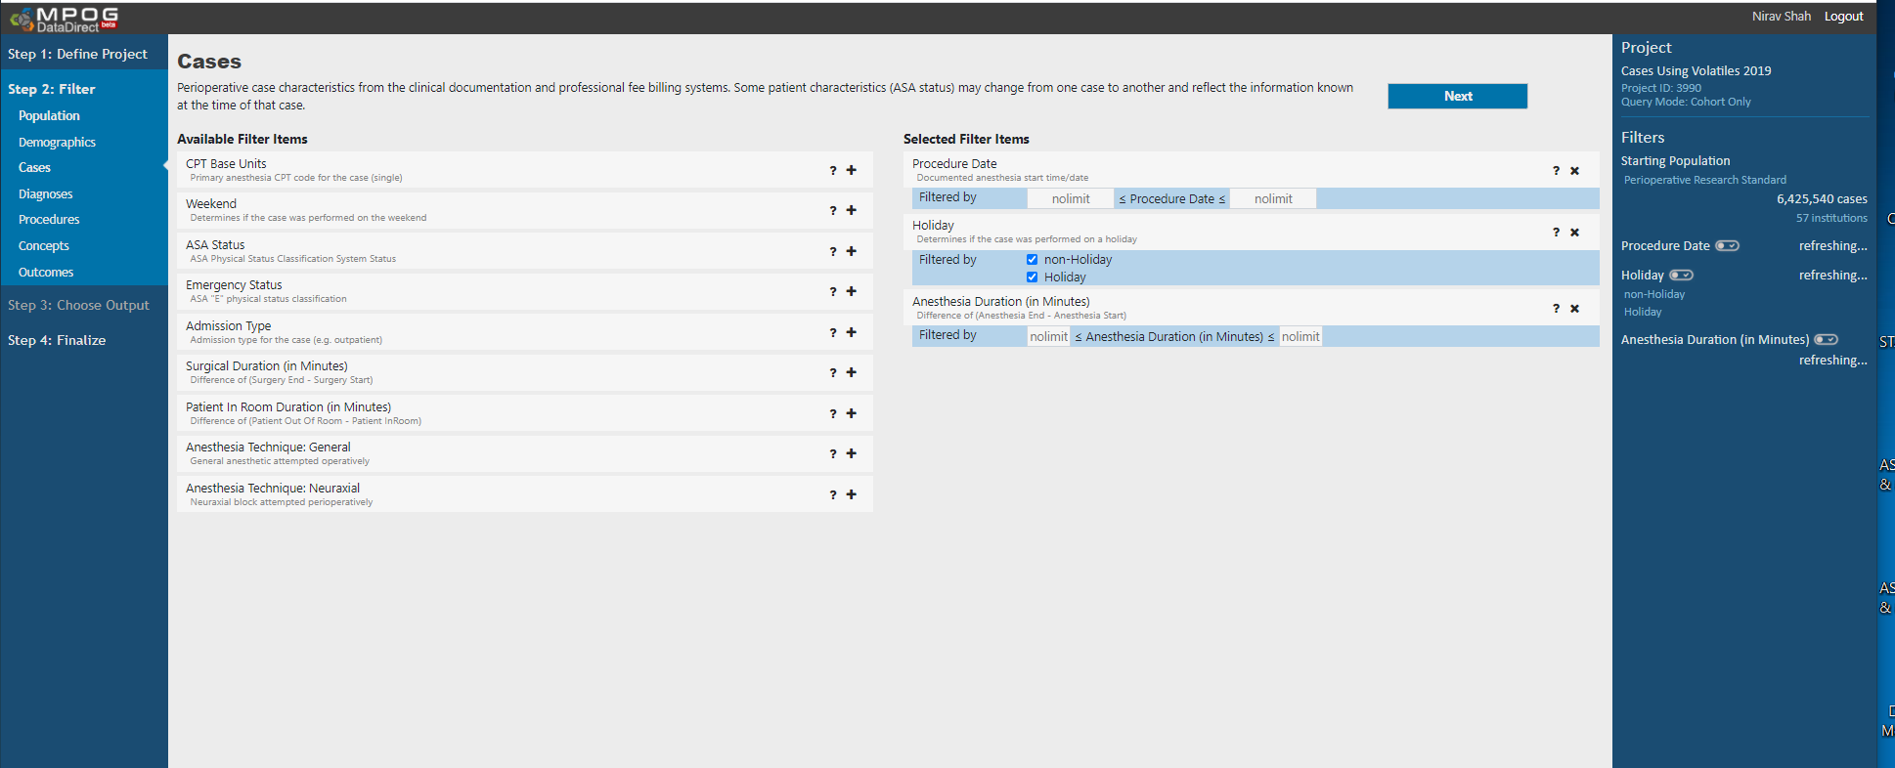
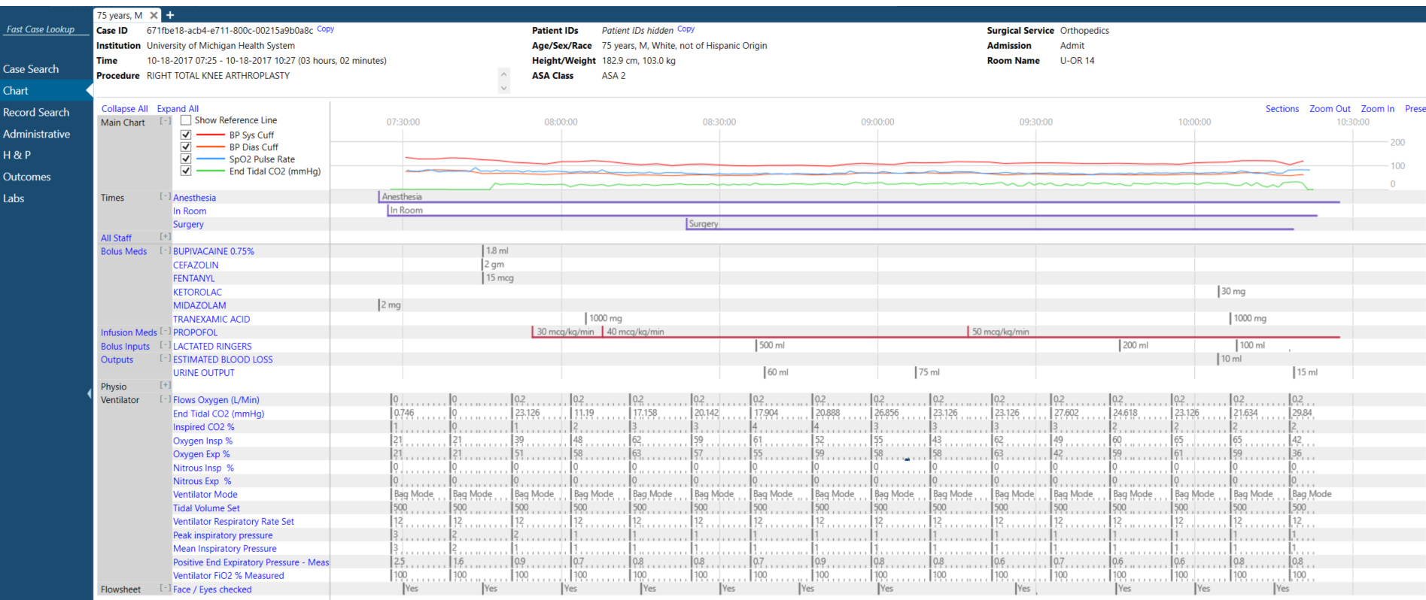
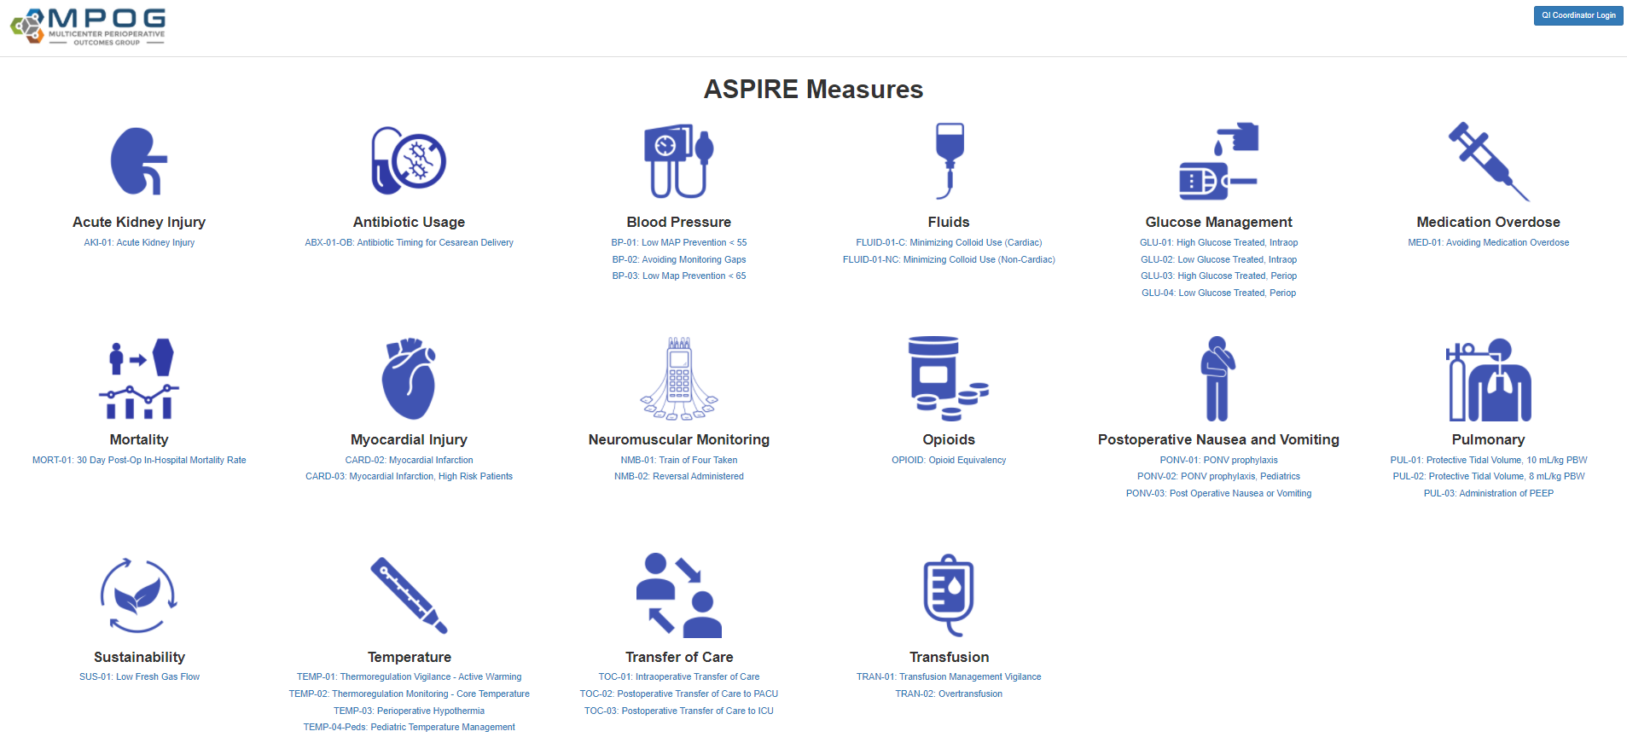
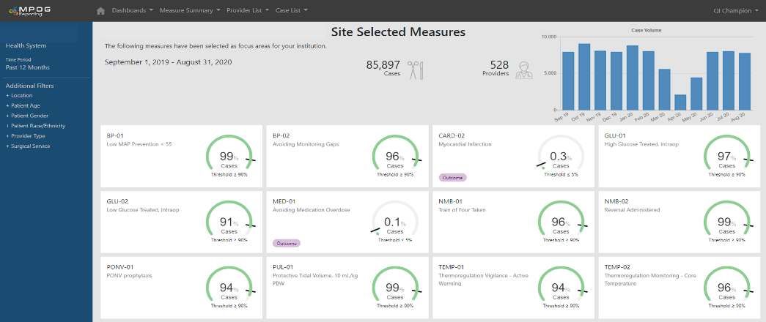
2019 – 2020 Development
DataDirect 2.0
CaseViewer 2.0
Measure Browser
QI Reporting

Slide 15
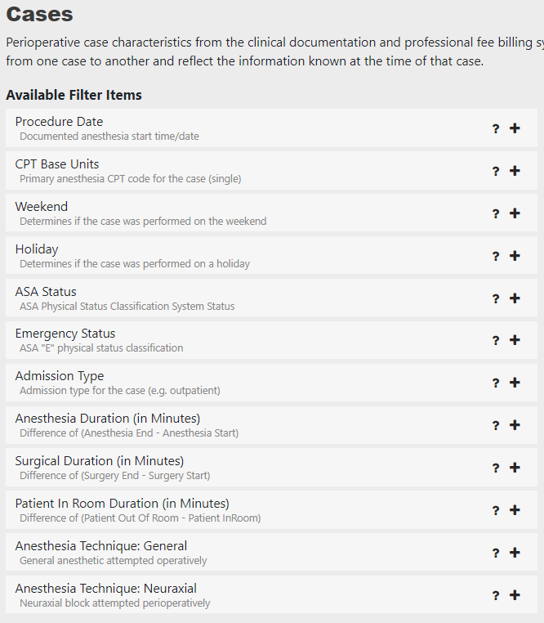
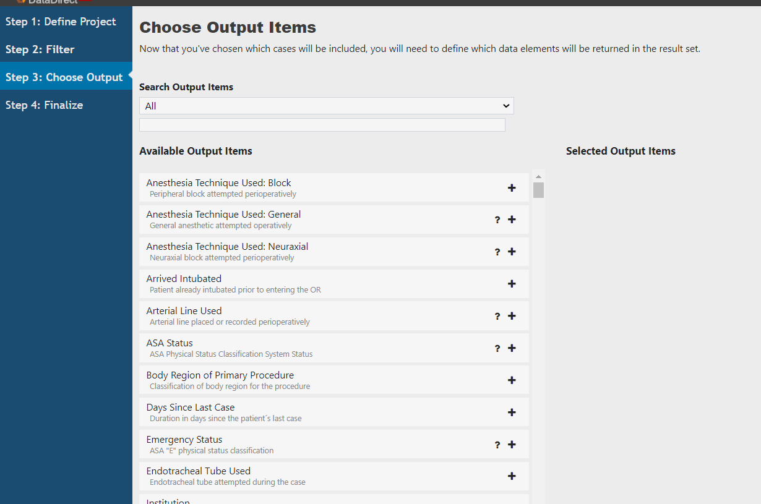
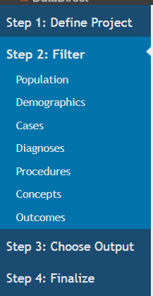
DataDirect 2.1
Data Driven Filters
Overhauled Outputs
Intuitive Categories

Slide 16
CaseViewer 2.0

Slide 17
CaseViewer 2.0
Removed banner clutter
Enhanced Search
Curated views
Intra-case Search
Updated organization

Slide 18
QI Reporting

Slide 19
QI Reporting
Specialty Dashboards
One click navigation
Updated Filters
Measure labels
Improved visualizations

Slide 20
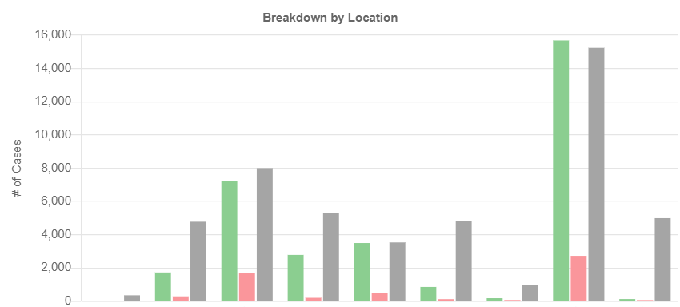
Updated Benchmarking
Intra-institutional comparison

Slide 21
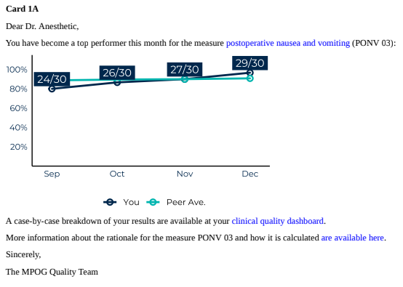
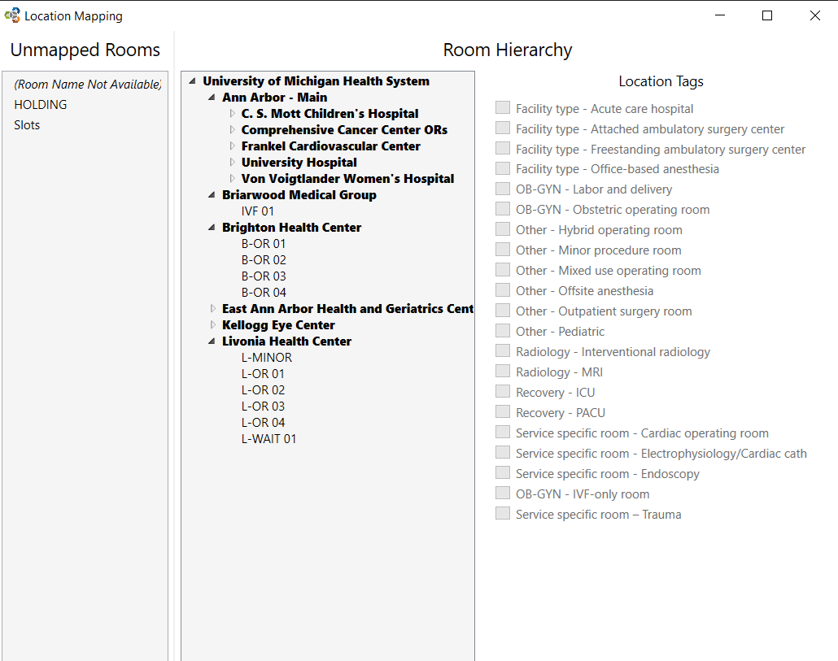
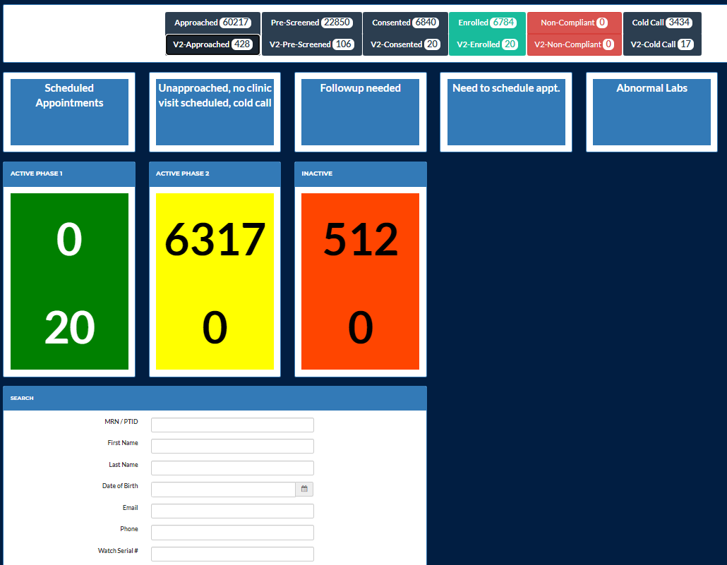
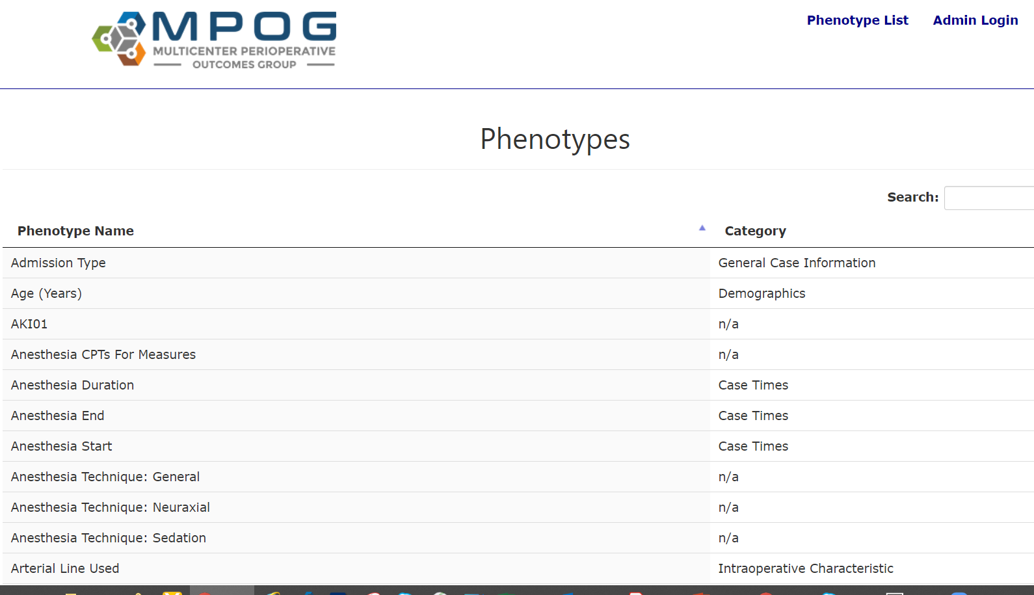
2021 Development Plans
Emails 2.0
Incremental updates to DataDirect and QI Reporting
App suite: Location Mapping overhaul
MQUARK: generalize clinical trial software
Infrastructure: more computed phenotypes

Slide 22
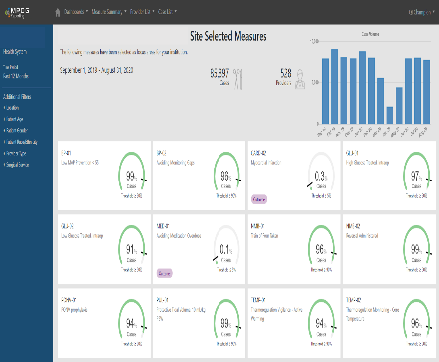
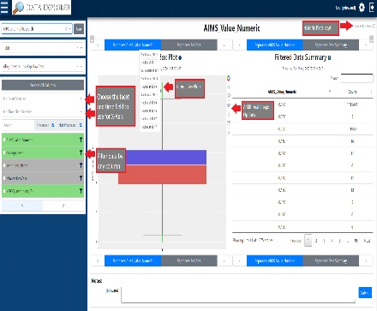
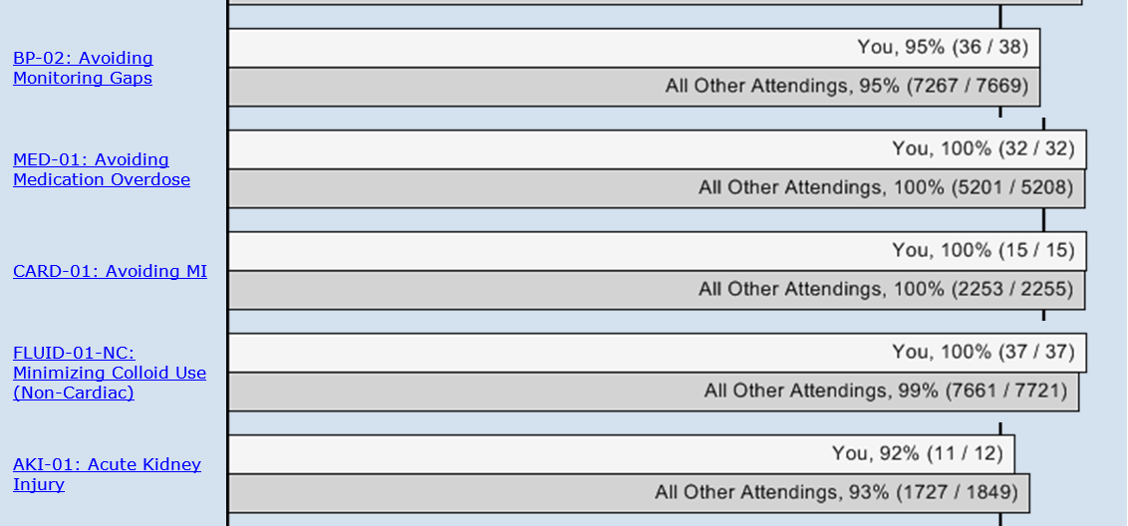
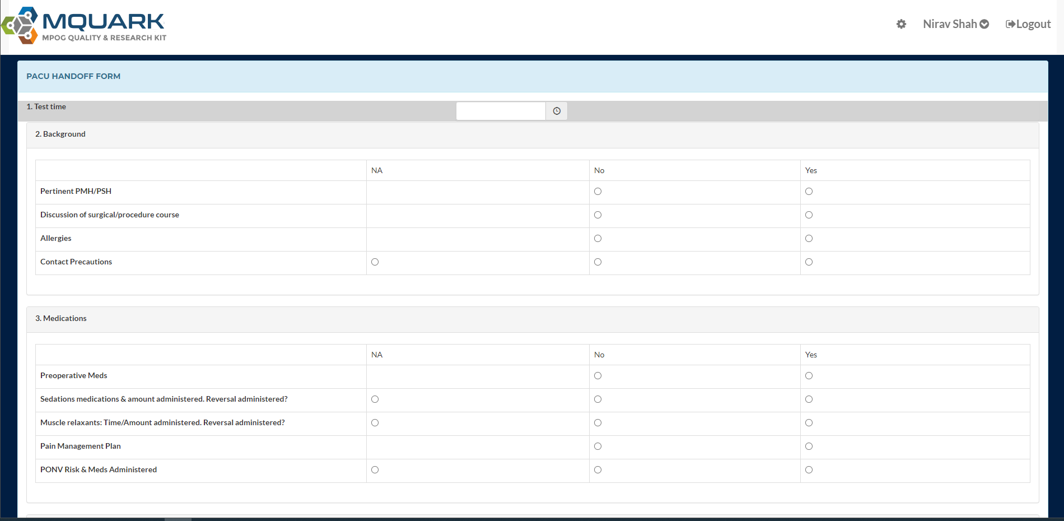
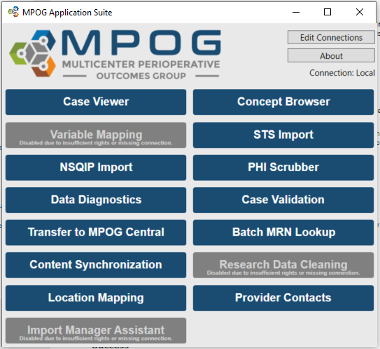
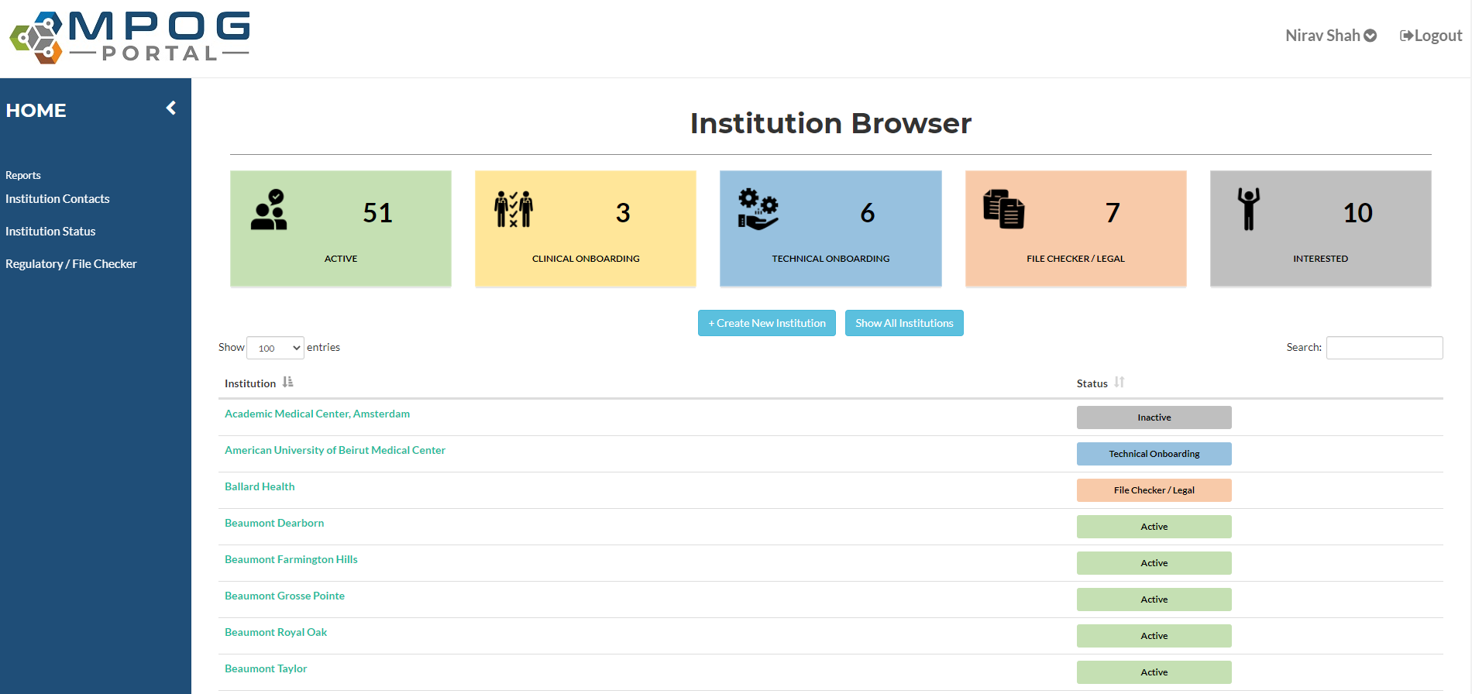
Goal: Apps that work together better
MPOG REGISTRY

Slide 23
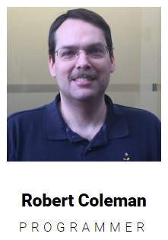
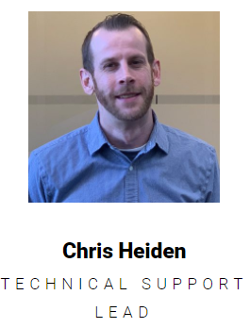
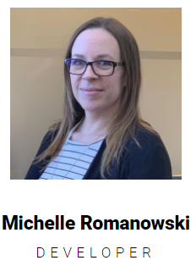
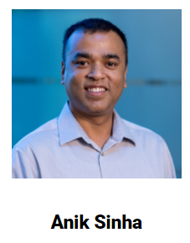

Slide 24
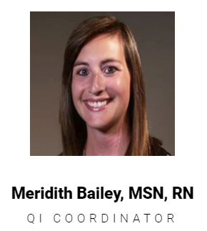
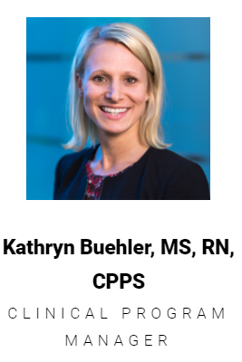
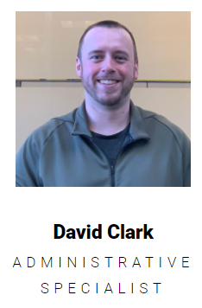
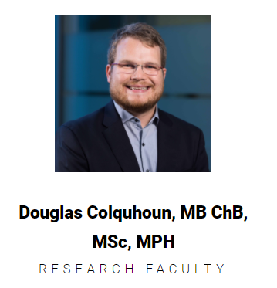
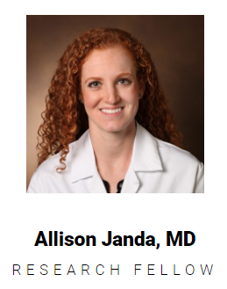
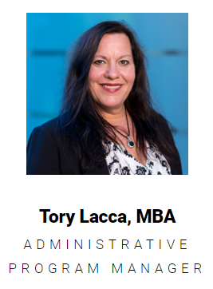
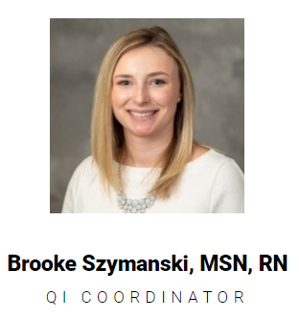

Slide 25
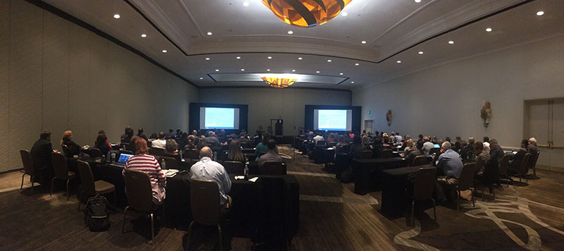

Slide 26
Discussion
Are we on the right track?
Are the development priorities the right ones?
What is missing?
What is overemphasized?

Slide 27
See you next year (in person)!

Slide 28
Thank You

