Slide 1
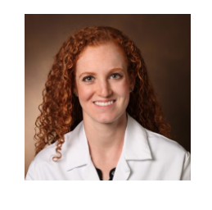
MPOG Cardiac Subcommittee Update
Allison Janda, MD
Clinical Lecturer, Department of Anesthesiology
Michigan Medicine

Slide 2
Our Cardiac Anesthesia QI Subcommittee
MPOG Team
Nirav Shah, MD – Director, Quality Improvement
Michael Mathis, MD – Associate Director, Research
Kate Buehler, MSN – Clinical Program Manager
Allison Janda, MD – Lead, Cardiac Anesthesia Subcommittee
Cardiac Anesthesiology Representatives joining us from around the US!

Slide 3
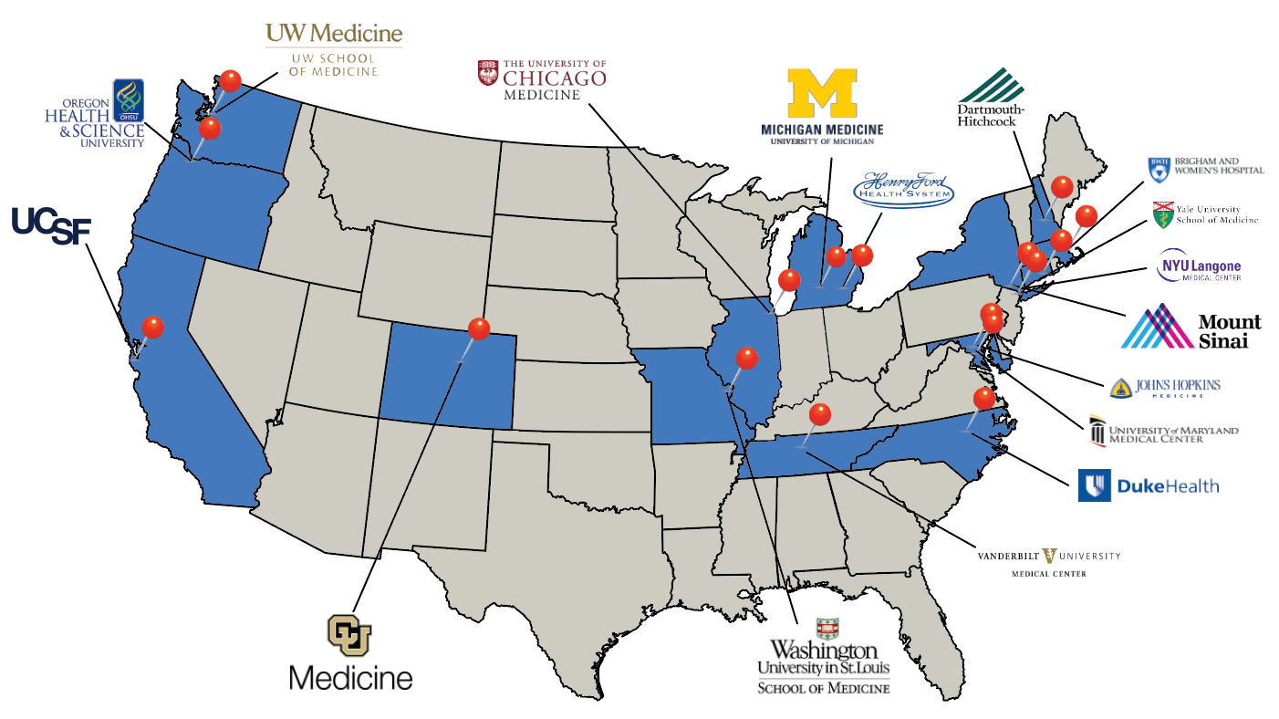

Slide 4
Our Subcommittee Members – Thank You!
Dr. Brandi Bottiger
Dr. Nazish Hashmi
Dr. Eric JohnBull
Dr. Negmeldeed Mamoun
Dr. Mihai Podgoreanu
Dr. Eleanor Vega
Dr. Danny Muelshlegel
Dr. Doug Shook
Dr. Dirk Varelmann
Dr. Cam Clark
Dr. Ying Low
Dr. Eric Davies
Dr. Jay Guruswamy
Dr. Gaurav Katta
Dr. Jake Abernathy
Dr. Michael Grant
Dr. Amanda Rhee
Dr. Brent Luria
Dr. Peter Neuburger
Dr. Valerie Sera
Dr. TJ Krall
Dr. Govind Rangrass
Dr. Josh Douin
Dr. Ashan Grewal
Dr. Anna Dubovoy
Dr. Ian Gannon
Dr. Allison Janda
Dr. Michael Mathis
Dr. Srdjan Jelacic
Dr. Yunwei Chen
Dr. Andrea Reidy
Dr. Josh Billings
Dr. Miklos Kertai
Dr. Clark Fisher
Dr. Robert Schonberger

Slide 5
What we’ve done…
First meeting was held on July 20, 2020
Discussed first potential measures for development
Glucose management
Post-bypass hypothermia avoidance
Plan to incorporate evidence-based guidelines in measures to ensure consistency and improve potential applications for QI and research purposes

Slide 6
MPOG Cardiac Research in Progress
Proposals accepted:
PCRC-10 Effect of Preoperative Antihypertensive Therapy on Intraoperative Systolic Blood Pressure Variability in Cardiac Surgery: Multicenter Perioperative Outcome Group (U of Tennessee)
PCRC-14 Perioperative Outcomes of Patients with Cardiac Implantable Electronic Devices (OHSU)
PCRC-79 Novel Assessments of Technical and Non-Technical Cardiac Surgery Quality (University of Michigan and Brigham and Women’s Hospital)
PCRC-93 Investigating the relationship between team familiarity and clinical outcomes in the context of cardiothoracic surgery (Brigham and Women’s Hospital)
PCRC-96 Multicenter Review of Practice Patterns Regarding Benzodiazepine Use in Cardiac Surgery (University of Michigan)
PCRC-106 Patient-, Provider-, and Institution-level Variation in Inotrope Use for Cardiac Surgery: A Multicenter Observational Analysis (University of Michigan)
PCRC-107 The association between hyperoxia during cardiac surgery and postoperative pulmonary compilations (PPCs) in the Multicenter Perioperative Outcomes Group (University of Colorado)

Slide 7
Goals
Build 1 cardiac-specific measure in 2020
Glucose management
Post-bypass hypothermia avoidance
Build 2-3 cardiac-specific measures in 2021
Antibiotic timing
Hypotension avoidance
AKI avoidance
Collaborate with the SCA and guideline committees to create consistent, evidence-based measures
Pursue STS-merged outcome reports 🡪 requires institutions to integrate with STS
Notes:
STS-Adult Cardiac Surgical Database (STS-ACSD, aka “STS Cardiac”) ->3 sites
STS-General Thoracic Surgical Database (STS-GTSD, “STS Thoracic”) ->8 sites
STS-Intemacs (LVAD database) ->tentative

Slide 8
Interested in joining the Cardiac Anesthesia Subcommittee?
Next meeting: October 9, 2020
If you would like to join, please email Allison Janda at:
ajanda@med.umich.edu

Slide 9
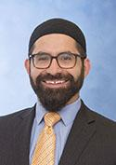
MPOG Pediatric Subcommittee Update
Bishr Haydar, MD
Associate Professor, Department of Anesthesiology
Michigan Medicine

Slide 10
MPOG Quality Team - Pediatrics
Pediatric Subcommittee reconvened December 2019 after a 2 year hiatus led by...
Bishr Haydar, MD - Michigan Medicine
Vikas O’Reilly-Shah, MD - Seattle Children’s
Brad Taicher, MD - Duke Children’s
Nirav Shah, MD – MPOG Director of Quality
Meridith Bailey, MSN – Program Lead, MPOG Pediatrics
Kate Buehler, MS,RN,CPPS– Clinical Program Manager
Participants have joined us from around the US and Netherlands!

Slide 11
Our Subcommittee Members - Thank you!!
Bishr Haydar, MD
Lisa Vitale, MD
Lori Reigger, MD
Shobha Malviya, MD
Vikas O’Reilly-Shah, MD
Amber Franz, MD
Joseph Cravero, MD
Morgan Brown, MD
Bob Brustowicz, MD
Steve Zgleszewski, MD
Jacques Scharoun, MD
Anastasia Grivoyannis, MD
Jina Sinskey, MD
Claudia Benkwitz, MD
Brad Taicher, MD
Lucy Everett, MD
Louis Tollinche, MD
Olga Eydlin, MD
Liem Pham, MD
Priti Dalal, MD
Shannon Grap, MD
Uma Parekh, MD
Jonathan Halem, MD
Hamid Vahabzadeh-Monshie, MD
Cheryl Gooden, MD
Alina Bodas, MD
Christy Crockett, MD
Carrie Menser, MD
Phillip Yun, MD
Ronak Patel, MD
Jim Fehr, MD
RJ Ramamurthi, MD
James Xie, MD
Julianne Mendoza, MD
Anshuman Sharma, MD
Charles Schrock, MD
Dan Roke, MD
Jeana Havidich, MD
Anna Clebone, MD
Notes:
64 Pediatric Anesthesiologists in total

Slide 12
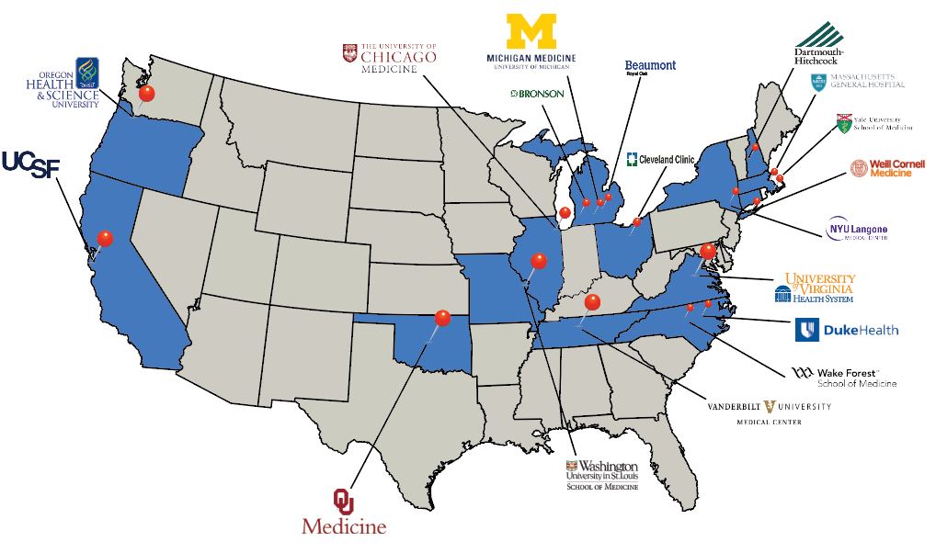
Notes:
MPOG Sites contributing pediatric data

Slide 13
What we’ve accomplished...
Measure Build | Status
Pediatric Temperature Management (TEMP-04) | Complete!
OME Pediatric Cohort #1 - Tonsillectomy/Adenoidectomy | Complete!
OME Pediatric Cohort #2 - Spine | Complete!
Non-Opioid Adjunct (PAIN-01) | December 2020

Slide 14
MPOG Pediatric Publications
Notes:
007 - Schonberger: Accepted Prevalence and trends of high body mass index in a multi-institution pediatric surgical population: A Report From the Multicenter Perioperative Outcomes Group (MPOG) (Yale)
018 – De Graaf: Published Ansthesiology 2018
038 – Lichtor: Submission to Journal of Pediatrics Anesthesia practice for pyloromyotomy: A retrospective analysis of care patterns from a national cohort (Yale)
046 – Riegger: Published Anesthesia & Analgesia 2020
068 – Rosenbloom: Presented to PCRC 9/17/18 Racial differences in induction times in pediatric anesthesia practice: A retrospective cohort study from the Multicenter Perioperative Outcomes Group Research Consortium (Massachusetts General Hospital)
090 – Montana: TBD Risk Factors for Persistent Severe Intraoperative Hypoxemia Among Pediatric Patients undergoing Non-cardiac Surgery (Washington University - St. Louis Children’s)
092 – Rosenbloom: Accepted The effect of induction time on intraoperative hypoxemia for pediatric patients undergoing anesthesia: a retrospective cohort analysis (Massachusetts General Hospital)
118 – Puglia: TBD Associations between the COVID pandemic and adherence to ASPIRE Quality Measures - Pediatric (Michigan Medicine)
124 - Legrand (PCRC 0102 Sub-analysis): Practice Patterns for Albumin Use in Pediatric Liver Transplantation (UCSF)
128 – Pryor/Tangel: TBD External validation of a Perioperative Risk Score to Predict Mortality after Pediatric Surgery (Weill-Cornell)

Slide 15
MPOG Pediatric Research in Progress...
In Submission to Journal of Pediatrics
Anesthesia practice for pyloromyotomy: A retrospective analysis of care patterns from a national cohort (Yale)
Pediatric Proposals Accepted
An Assessment of Risk Factors for Hypoxemia in Young Children Undergoing One Lung Ventilation (Wake Forest)
The effect of induction time on intraoperative hypoxemia for pediatric patients undergoing anesthesia: a retrospective cohort analysis (Massachusetts General Hospital)
Prevalence and trends of high body mass index in a multi-institution pediatric surgical population: A Report From the Multicenter Perioperative Outcomes Group (MPOG) (Yale)
Pediatric Proposals Submitted
Racial differences in induction times in pediatric anesthesia practice: A retrospective cohort study from the Multicenter Perioperative Outcomes Group Research Consortium (Massachusetts General Hospital)
Risk Factors for Persistent Severe Intraoperative Hypoxemia Among Pediatric Patients undergoing Non-cardiac Surgery (Washington University - St. Louis Children’s)
Associations between the COVID pandemic and adherence to ASPIRE Quality Measures - Pediatric (Michigan Medicine)
External validation of a Perioperative Risk Score to Predict Mortality after Pediatric Surgery (Weill-Cornell)
Practice Patterns for Albumin Use in Pediatric Liver Transplantation (University of California San Francisco)
Notes:
007 - Schonberger: Accepted Prevalence and trends of high body mass index in a multi-institution pediatric surgical population: A Report From the Multicenter Perioperative Outcomes Group (MPOG) (Yale)
018 – De Graaf: Published Ansthesiology 2018
038 – Lichtor: Submission to Journal of Pediatrics Anesthesia practice for pyloromyotomy: A retrospective analysis of care patterns from a national cohort (Yale)
046 – Riegger: Published Anesthesia & Analgesia 2020
068 – Rosenbloom: Presented to PCRC 9/17/18 Racial differences in induction times in pediatric anesthesia practice: A retrospective cohort study from the Multicenter Perioperative Outcomes Group Research Consortium (Massachusetts General Hospital)
090 – Montana: TBD Risk Factors for Persistent Severe Intraoperative Hypoxemia Among Pediatric Patients undergoing Non-cardiac Surgery (Washington University - St. Louis Children’s)
092 – Rosenbloom: Accepted The effect of induction time on intraoperative hypoxemia for pediatric patients undergoing anesthesia: a retrospective cohort analysis (Massachusetts General Hospital)
118 – Puglia: TBD Associations between the COVID pandemic and adherence to ASPIRE Quality Measures - Pediatric (Michigan Medicine)
124 - Legrand (PCRC 0102 Sub-analysis): Practice Patterns for Albumin Use in Pediatric Liver Transplantation (UCSF)
128 – Pryor/Tangel: TBD External validation of a Perioperative Risk Score to Predict Mortality after Pediatric Surgery (Weill-Cornell)

Slide 16
2021 Goals
Pediatric Measure Build
Intraoperative Hypotension (informational)
Postoperative Respiratory Complications
Collaborate with the SPA Quality & Safety Committee to gain expert consensus on pediatric revisions needed for existing MPOG measures.
Pursue opportunities with NSQIP-Peds or Wake Up Safe 🡪 Data integration

Slide 17
Interested in Joining the Pediatric Subcommittee?
Next meeting: October 6, 2020
2-3pm EST via Zoom
Participants from outside of MPOG are welcome to join!
Contact Meridith Bailey if interested: meridith@med.umich.edu

Slide 18
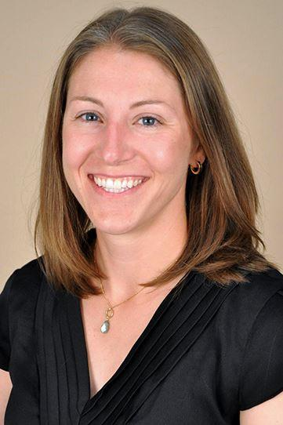
MPOG Obstetric Subcommittee Update
Rachel Kacmar, MD
University of Colorado

Slide 19
Our Obstetric Anesthesia QI Subcommittee
MPOG Team
Nirav Shah, MD – MPOG Director of Quality
Michael Mathis, MD – MPOG Director of Research
Brooke Szymanski-Bogart, MSN, RN – QI Coordinator
Obstetric Anesthesiology Representatives joining us from around the US!

Slide 20
Thank you to our subcommittee members!
Tom Klumpner, MD
Joanna Kountanis, MD
Carlo Pancaro, MD
Sharon Abramovitz, MD
Brandon Togioka, MD
Wandana Joshi, MD
Dan Biggs, MD
Angel Martino-Horrall, MD
Ashraf Habib, MD
Marie-Louise Meng, MD
Traci Coffman, MD
David Swastek, MD
Jenifer Henderson, MD
Carlos Delgado Upegui, MD
Eric Davies, MD
Ami Attali, MD
Joshua Younger, MD
Ronald George, MD
Stephanie Lim, MD
Mohamed Tiouririne, MD
Arvind Palanisamy, MD
Ghislaine Echevarria, MD
Rachel Kacmar, MD

Slide 21
What we’ve done…
First meeting was held on in September 2017 and reconvened in December 2019
Met in March and July 2020
Next meeting: October 2020
Modified existing ASPIRE measures to either exclude obstetric patients or modified inclusion criteria (OB hemorrhage protocol considerations for TRAN 02)
Call for Measures survey in 2020 to identify focus areas
Released first OB-specific measure in July 2020: ABX 01 (OB) Antibiotic timing for cesarean delivery
Currently building BP 04 (OB): Prolonged hypotension for cesarean delivery

Slide 22
Goals
Build 2-3 obstetric-specific measures in 2021
Collaborate with the SOAP and guideline committees to create measures that are as consistent and evidence-based as possible

Slide 23
Interested in joining the Obstetric Anesthesia Subcommittee?
Next meeting: October 20, 2020
If you would like to join, please email Rachel Kacmar: Rachel.Kacmar@cuanschutz.edu or the MPOG Coordinating Center support@mpog.zendesk.com

